Slide 1
Deepening our understanding of equity
Health Equity Learning Community
November 2017

Slide 2
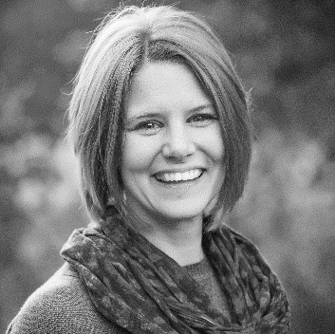
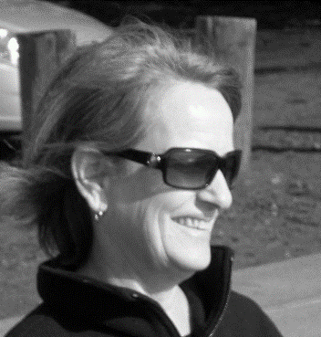
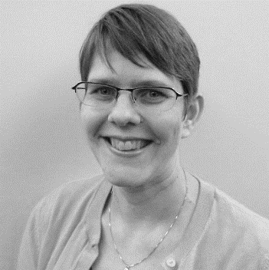
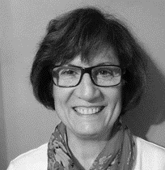
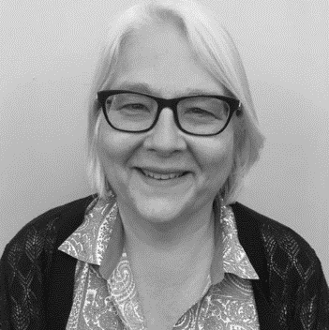
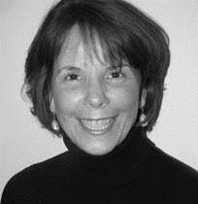
Welcome
Chelsie
Huntley
Julia
Ashley
Phyllis
Brashler
Susan
Brace-Adkins
Jeannette
Raymond
Kim
Gearin
Notes:
Introductions
You can let us know who is on the webinar with us by entering your attendance into the chat box.
We’ll be recording today’s webinar to make sure we can capture the rich discussion adequately, without having to rely on my bad memory.
Today we’re going to act on some advice we heard from our Steering Committee—and that is to attend to the personal journey that goes with advancing equity.
We’ll do that by watching some videos together – videos that tell stories that can help us relate to and understand equity and inequity.
Some of you may be familiar with Camara Jones – she is the immediate past president if the American Public Health Association, a family physician and epidemiologist. She uses allegories and analogies to help communicate complex ideas about social determinants of health, racism, and health equity. You may have seen these videos before—but we’ve found, as staff, that each time we listen, we hear something new.
Before we start, a reminder: we’re all at different places in thinking about and working on health equity. As we view and talk about the videos, truly, there are no right or wrong answers. This is a safe space—you’ll find no judgment here, just open inquiry and exploration in the spirit of learning together.

Slide 3
Video instructions
Follow the link in the chat box.
We’ll mute the lines.
Watch the video on your computer, then come back when it’s done.
In the interest of time – forward the video to the 2:32 mark and start there.
Come back to the WebEx when you’ve finished.

Slide 4
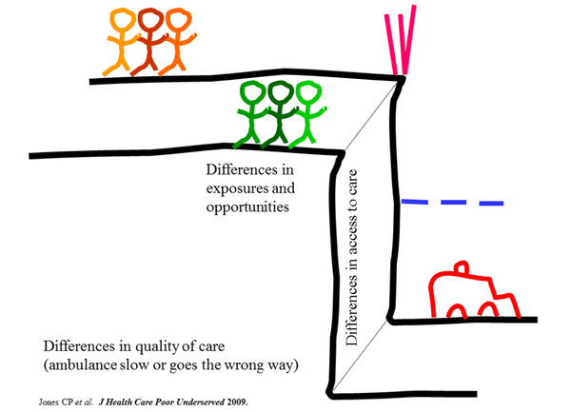
Camara Jones: Cliff analogy
Notes:
Look at the discussion questions on your handout for this meeting. Talk with your team for about 7 minutes, then we’ll come back together and discuss as a group.
Cliff analogy of health (14:55), Camara Jones at the University of Denver

Slide 5
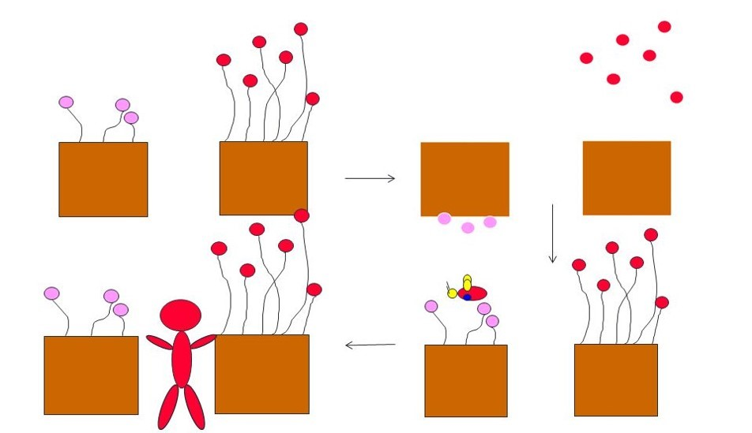
Camara Jones: The Gardener’s Tale
Notes:
Look at the discussion questions on your handout for this meeting. Talk with your team for about 7 minutes, then we’ll come back together and discuss as a group.
Allegories on race and racism: The gardener's tale (6:55 to 17:12), Camara Jones at TEDxEmory

Slide 6
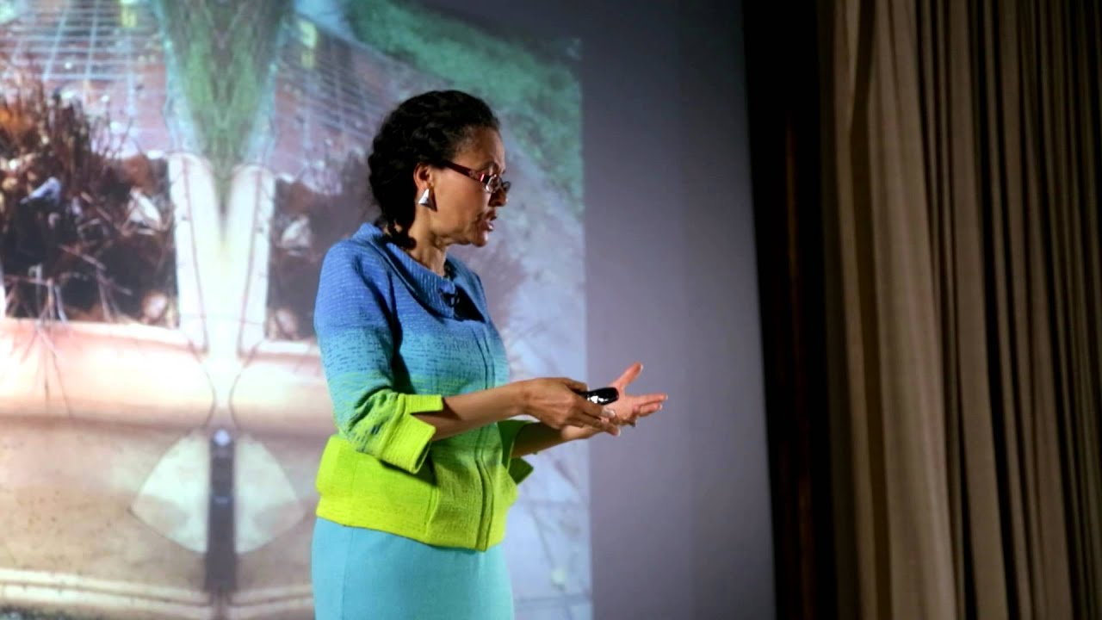
Optional: Camara Jones: Life on a conveyor belt
Notes:
Optional 3rd discussion – The Conveyer Belt
What did you hear in this allegory about the conveyer belt?
What feelings come up for us as we imagine being on that conveyer belt, and turning around to go the other direction?
How can this allegory help us advance equity?
Optional: Allegories on race and racism: Life on a conveyor belt (17:12 to 20:31), Camara Jones at TEDxEmory

Slide 7
Next steps
Use your coach
Take the next right step
Practice using an equity lens!
Notes:
Thank you for sharing your thoughts and insights with us today. I appreciate all that I’ve learned from you about what it means to do this work.
A few things you can do between now and our next meeting:
Continue to use your coaches for support and any resources you might need.
Take a step forward, whatever that step might be for you and your team, to keep moving.
Every day we’re presented with opportunities to ask different questions of ourselves and each other. As you go about each day, practice applying a health equity lens to whatever you’re working on. The more you exercise that muscle, the more routine it becomes.
Thanks everyone – we’ll talk with you again soon. Have a great rest of your day.

