Slide 1
Management of High Consequence Infectious Disease (HCID) Toolbox for Frontline Health Care Facilities
https://www.health.state.mn.us/diseases/hcid/index.html

Slide 2
HCID Background

Slide 3
HCID Toolbox Executive Summary
We live in a world where people travel the globe and pathogens evolve. These forces make health care facilities throughout the state vulnerable to risks posed by High Consequence Infectious Diseases (HCID) infections, such as Ebola Virus Disease (EVD), Middle East Respiratory Syndrome, and others that are easily transmissible, highly fatal, and not preventable through routine vaccines. Delayed detection and isolation of HCIDs may result in spread to others in health care facilities and the community.
The Minnesota Department of Health (MDH), the Minnesota Chapter of the Association for Infection Control and Epidemiology (APIC MN), and the Health Care Coalitions of Minnesota worked collaboratively to develop this toolbox to help frontline facilities prepare for presentation of a person with a High Consequence Infectious Disease (HCID).

Slide 4
High Consequence Infectious Diseases (HCID)
A HCID is defined by the Minnesota HCID Collaborative* as a disease that:
All forms of medical waste are classified as Category A infectious substances (UN2814) by the U.S. Department of Transportation or
Has potential to cause a high mortality among otherwise healthy people and
no routine vaccine exists and
some types of direct clinical specimens pose generalized risks to laboratory personnel or
risk of secondary airborne spread or unknown mode of transmission
* MN HCID Collaborative: MN Department of Health, Mayo Clinic, University of Minnesota Medical Center, Minnesota Hospital Association, Minnesota Health Care Coalitions, Minnesota HCID-Ready EMS services

Slide 5
HCID for which no routine vaccine is currently available broken down by categories
 |  |  | HCID for which no routine vaccine currently available
Syndrome | Pathogen Examples | Category A waste | Generalized laboratory risk from direct clinical specimens | Risk of airborne spread in healthcare settings or unknown mode of transmission
Unknown highly fatal disease with evidence of person-to-person spread |  | Yes | Yes | Yes
Hemorrhagic fever | Ebola virus, Marburg virus, Lassa virus, Crimean-Congo virus, Guanarito virus, Machupo virus, Junin virus, Sabia virus, Lujo virus, Chapare virus, Kayasnur Forest Disease, Omsk Hemorrhagic Fever, Hantaviruses causing HFRS | Yes | Yes | Yes/No (none are known to be transmitted via airborne spread, but all potential modes of transmission may be unknown for some rare pathogens)
Poxvirus diseases | Variola (smallpox) virus, Monkeypox | Yes | Yes | Yes
Febrile neurological or respiratory illness | Nipah virus, Hendra virus | Yes | ? | Yes (Nipah virus only)
Febrile respiratory illness | MERS-CoV, SARS-CoV, Pandemic Influenza | No | No | Yes

Slide 6
2016 Emergency Preparedness Final Rule
Published September 16, 2016
Implementation date November 15, 2017
Applies to all 17 provider and supplier types
Compliance required for participation in Medicare
The facility must develop and maintain an emergency plan and update annually
February 1, 2019: CMS updated Appendix Z of the State Operations Manual to add emerging infectious disease threats to the definition of all-hazards approach. Examples include influenza, Ebola, Zika virus, and others.

Slide 7
For Provisions Required for All Provider Types
Notes:
Emergency Preparedness Program
Develop an emergency plan based on an “all hazards” risk assessment. Review Annually. Infectious agents should be listed.
Develop policies and procedures based on the plan and risk assessment. Review annually. Should have special procedures for infectious agents.
Develop a communications plan that coordinated patient care within the facility, across health care providers, and with state and local public health departments and emergency management systems. Review annually.
Develop and maintain training and testing programs, including initial training in policies and procedures. Demonstrate knowledge of emergency procedures and provide training annually. Conduct drills and exercises to test the emergency plan.

Slide 8
There are 8 Health Care Coalitions in Minnesota to Help Facilities With Emergency Planning
Northwest Health Services Coalition
Northeast Health Care Preparedness Coalition
West Central Health System Preparedness Coalition
Central Health Care System Preparedness Coalition
Metro Health and Medical Preparedness Coalition
Southwest Emergency Preparedness Team
South Central Health Care Coalition
Southeast Minnesota Disaster Health Coalition

Slide 9
Why prepare for HCIDs?
Risk assessment may show likelihood of patient presenting with HCID is typically low, and temporarily increases when hotspots of disease activity occur.
Consequence assessment reveals major negative impacts resulting from delayed identification and isolation of patients with HCIDs
Notes:
While the risk may be low that a patient with a HCID will present to a healthcare facility, the consequence of such a patient presenting for care can be huge.

Slide 10
Examples of high consequences…

Slide 11
Example 1
Febrile patient presented to Dallas hospital. Reported travel to Liberia. Diagnosed with sinusitis and sent home.
Two health care providers infected with Ebola when he returned with worse symptoms.

Slide 12
Example 2
Delayed isolation of index patient led to:
186 cases, 38 deaths
Transmission in 16 clinics and hospitals
$8.5 billion US dollars in economic loss
Oh M, et al. Korean J Intern Med.2018;33:233-246.

Slide 13
What do these two cases have in common?
Both:
Presented to frontline facilities
Rare infections, but presented like common illnesses
Delayed detection led to transmission in facilities

Slide 14
Recent HCID Outbreaks Around the World
Notes:
Ebola, Democratic Republic of Congo, 2018-19
Lassa Fever, Nigeria, 2018
Middle East Respiratory Syndrome, Middle East, ongoing activity and South Korea, 2015
Nipah Virus, India, 2018

Slide 15
Why Another Toolbox
A patient with HCID could present to any facility that provides acute care (e.g., emergency department, urgent care, primary care) at any time
Delays in identification and isolation of persons HCIDs leads to transmission to others and possibly large deadly outbreaks
However, HCIDs are rare so preparing for them is often neglected
Preparing for HCIDs can help reduce transmission of more common infections
So, the toolbox:
Applies lessons from the 2014-15 Ebola outbreak to manage other HCIDs
Provides “Grab and Go” tools to make preparedness easy
Provides a suggested standard for Minnesota hospitals
Provides tools that bolster routine infection prevention (symptom screening, respiratory etiquette, hand hygiene, personal protective equipment, transmission-based isolation)

Slide 16
HCID Toolbox
Overview

Slide 17
Goals of the Toolbox
Prepare frontline facilities to effectively identify and isolate a patient who may have a HCID and to correctly inform key partners.
Incorporate HCID preparedness into and reinforce annual education of the basic infection prevention principles of standard precautions, transmission based isolation, personal protective equipment, hand hygiene, and health care provider safety.
Help facilities meet regulatory requirements.

Slide 18
Big Picture Toolbox Concepts
Can’t plan for every rare event, so focuses on infection control principles
Aim is to make HCID preparedness business as usual…
applicable to mundane as well the exotic infections
integrated in routine workflows across the continuum of care
incorporated into annual training
All facilities are unique, so implementation of the tools will vary
All tools are editable and can be tailored to the facility

Slide 19
CDC Tiered Approach
All Hospitals are Frontline Hospitals and should be able to
Identify and Isolate a person with an HCID
Inform infection prevention and state & local public health
Have enough personal protective equipment to manage a patient for 24 hours

Slide 20
Tiered Approach in Minnesota
Frontline Facility is:
Every hospital (and clinic)
Treatment Hospitals are:
University of Minnesota Medical Center - Minneapolis
Mayo Clinic - Rochester

Slide 21
HCID Toolbox on the MDH Website
High Consequence Infectious Disease (HCID) Toolbox for Frontline Health Care Facilities (https://www.health.state.mn.us/diseases/hcid/index.html)
Grab and Go tools
Suggested standard for Minnesota hospitals
Bolster routine infection prevention (symptom screening, respiratory etiquette, hand hygiene, personal protective equipment, transmission-based isolation)
Help facilities meet regulatory requirements

Slide 22
Components of the Toolbox
Executive Summary
Purpose
How to use the tools
Planning tools
Training tools
Exercises – mini drills
Readiness binder
Links to references
Request an ICAR visit (assessment and assistance)

Slide 23
Obtain Leadership Support for Engagement
Critical to the success of the program to support people to play
Leadership needs justification to allot resources:
Patient safety
Employee safety
Regulatory requirements
Quantify in hours, how much time is planned for the year

Slide 24
HCID Toolbox: Planning Tools

Slide 25
Start with the Planning Tools
Compete the Needs Assessment - List and prioritize the gaps (short version) - Centers for Enhanced Response (CER) Assessment (longer version for more detailed self assessment)
Fill out the “Multi-year Panning, Training, and Exercise Plan Template”
Start with education if not already in place
Pick out scenarios
Engage leadership and Emergency Preparedness Committee

Slide 26
Sample Needs Assessment Questionnaire
Sample only intended to stimulate some assessment ideas.
Answering “no” to any of these questions could be an area in your plan that needs to be exercised.

Slide 27
Center for Enhanced Response (CER) Assessment
CER Assessment includes deeper assessment of preparedness
Establish partnership with MN Department of Health

Slide 28
Planning, Training, and Exercise Plan
Create Multi-year Planning, Training, and Exercise Plan
Incorporate into facility’s plan

Slide 29
HCID Toolbox: Training Tools

Slide 30
Then Move to the Training Tools
High Consequence Infectious Disease Screening tool
Slide Sets to pick and choose for facility training
Toolbox components
HCID specific slides
Fun PPE Video Vignettes – for use in HCID training and general PPE training

Slide 31
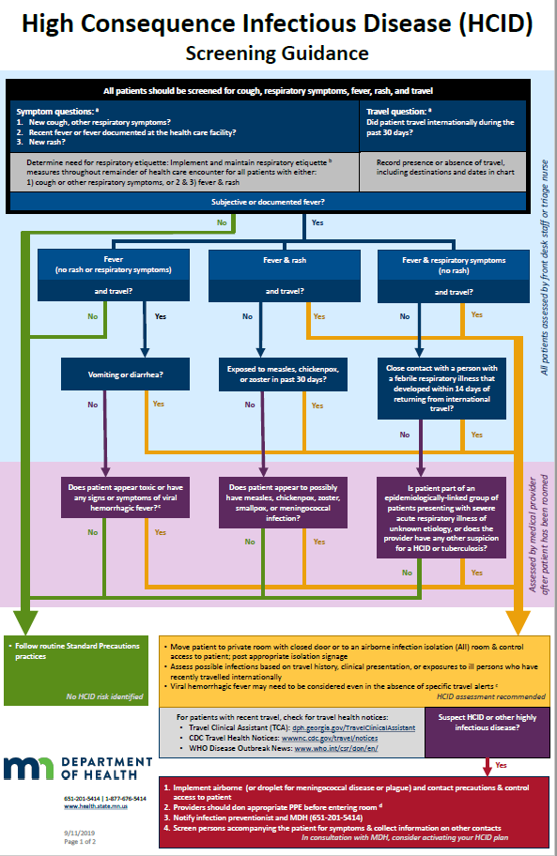
HCID Screening Guidance
A suggested framework to aid with the Identify, Isolate and Inform components of HCID preparedness
Impact not limited to HCIDs; designed to prevent spread of both common and are rare infections
Emphasizes respiratory etiquette
4 short questions for all patients
1 additional question in some circumstances

Slide 32
Assessed by Front Desk or Triage Nurse
Notes:
Screenshot is blown up to show:
All patients should be screened for cough, respiratory symptoms, fever, rash, and travel
Symptom questions: 1) New cough, other respiratory symptoms? 2) Recent fever or fever documented at the health care facility? 3) New rash?
This determines need for respiratory etiquette: Implement and maintain respiratory etiquette measures throughout remainder of health care encounter for all patients with either: 1) cough or other respiratory symptoms, or 2) and 3) fever and rash
If no subjective or documented fever, follow routine standard precautions practices; no HCID risk identified
Travel question: Did patient travel internationally during the past 30 days? Record presence or absence of travel, including destinations and dates in chart

Slide 33
Assessed by Front Desk or Triage Nurse: Fever
Notes:
Moving through the assessment this part of the questionnaire shows how the front desk or triage nurse should assess patients with:
Fever (no rash or respiratory symptoms) and travel, then if there is vomiting or diarrhea
Fever and rash and travel, then if they were exposed to measles, chickenpox, or zoster in past 30 days
Fever and respiratory symptoms (no rash) and travel, then close contact with a person with febrile respiratory illness that developed within 14 days of returning from international travel
In cases of answering yes, the assessment instructs:
Move patient to private room with closed door or to an airborne infection isolation (All) room and control access to patient; post appropriate isolation signage
Assess possible infections based on travel history, clinical presentation, or exposures to ill person who have recently travelled internationally
Viral hemorrhagic fever may need to be considered even in the absence of specific travel alerts
HCID assessment recommended

Slide 34
Assessed by Provider (purple and yellow areas)
Notes:
Moving through the assessment this part of the questionnaire shows how the provider should ask:
Does patient appear toxic or have any signs or symptoms of viral hemorrhagic fever?
Does patient appear to possibly have measles, chickenpox, zoster, smallpox, or meningococcal infection?
Is patient part of an epidemiologically-linked group of patients presenting with severe acute respiratory illness of unknown etiology, or does the provider have any other suspicion for a HCID or tuberculosis?
In cases of answering yes, the assessment instructs:
Move patient to private room with closed door or to an airborne infection isolation (All) room and control access to patient; post appropriate isolation signage
Assess possible infections based on travel history, clinical presentation, or exposures to ill person who have recently travelled internationally
Viral hemorrhagic fever may need to be considered even in the absence of specific travel alerts
HCID assessment recommended

Slide 35
Assessed by Provider
Notes:
Move patient to private room with closed door or to an airborne infection isolation (All) room and control access to patient; post appropriate isolation signage
Assess possible infections based on travel history, clinical presentation, or exposures to ill person who have recently travelled internationally
Viral hemorrhagic fever may need to be considered even in the absence of specific travel alerts
HCID assessment recommended
For patients with recent travel, check for travel health notices:
Travel Clinical Assistant (TCA): dph.Georgia.gov/TravelClinicalAssistant
CDC Travel Health Notices: wwwnc.cdc.gov/travel/notices
WHO Disease Outbreak News: www.who.int/csr/don/en/
If the provider suspects HCID or other highly infectious disease, they should:
Implement airborne (or droplet for meningococcal disease or plague) and contact precautions and control access to patient
Providers should don appropriate PPE before entering room
Notify infection preventionist and MDH (651-201-5414)
Screen persons accompanying the patient for symptoms and collect information on other contacts
Activate HCIDs plans, including possible transfer to biocontainment unit

Slide 36
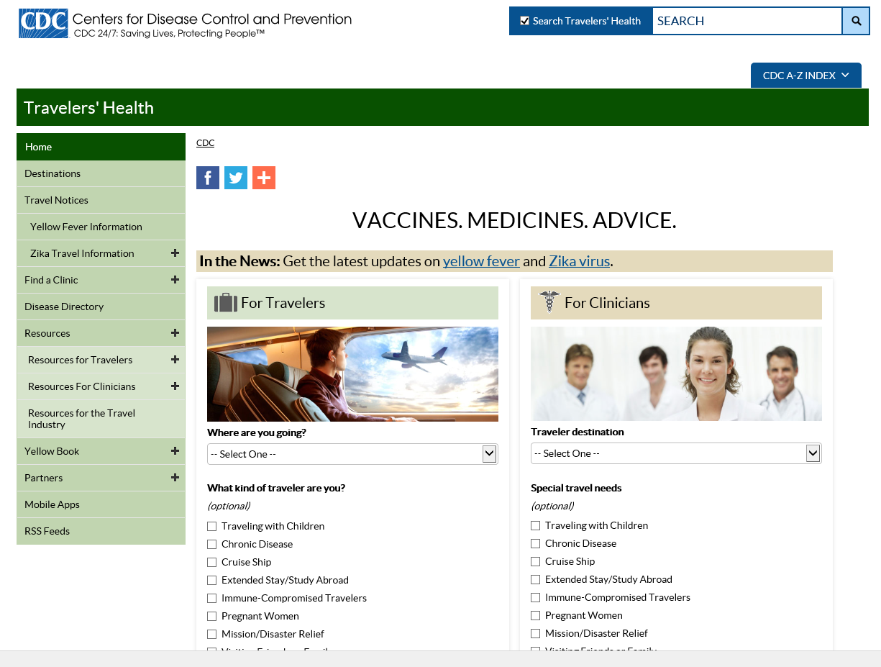
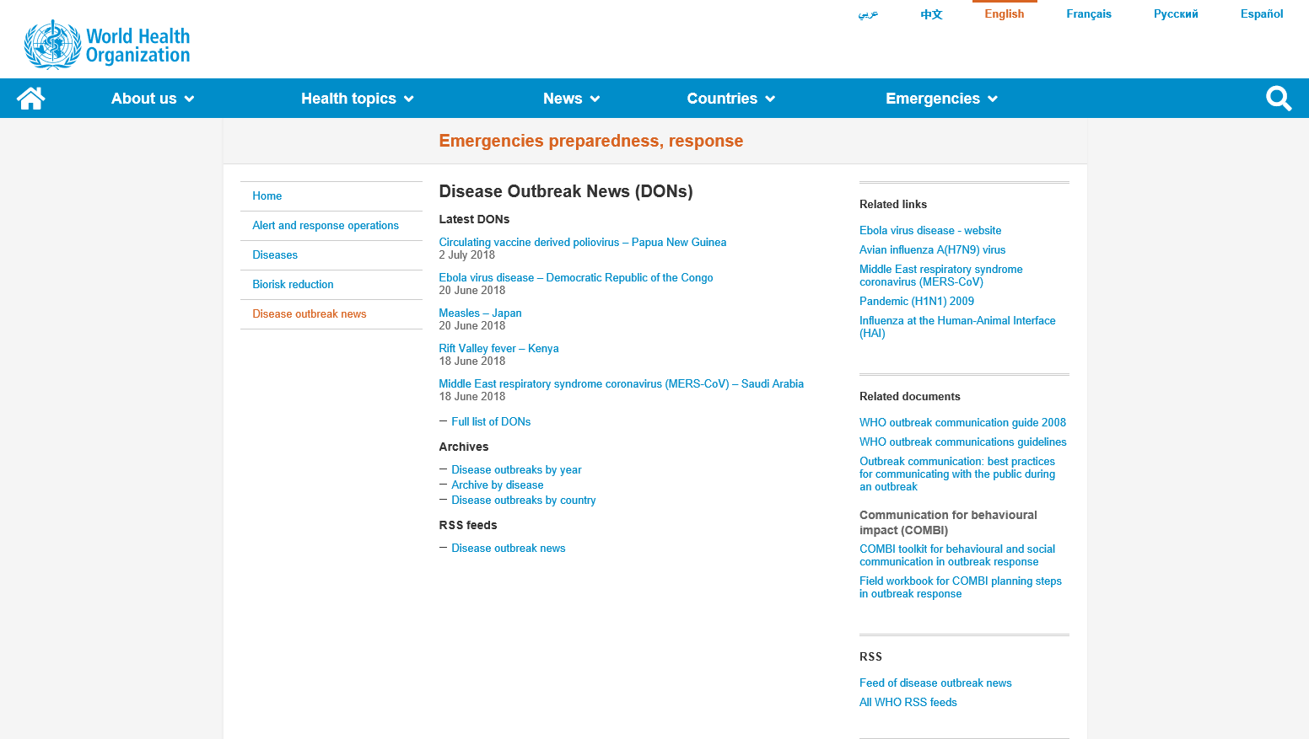
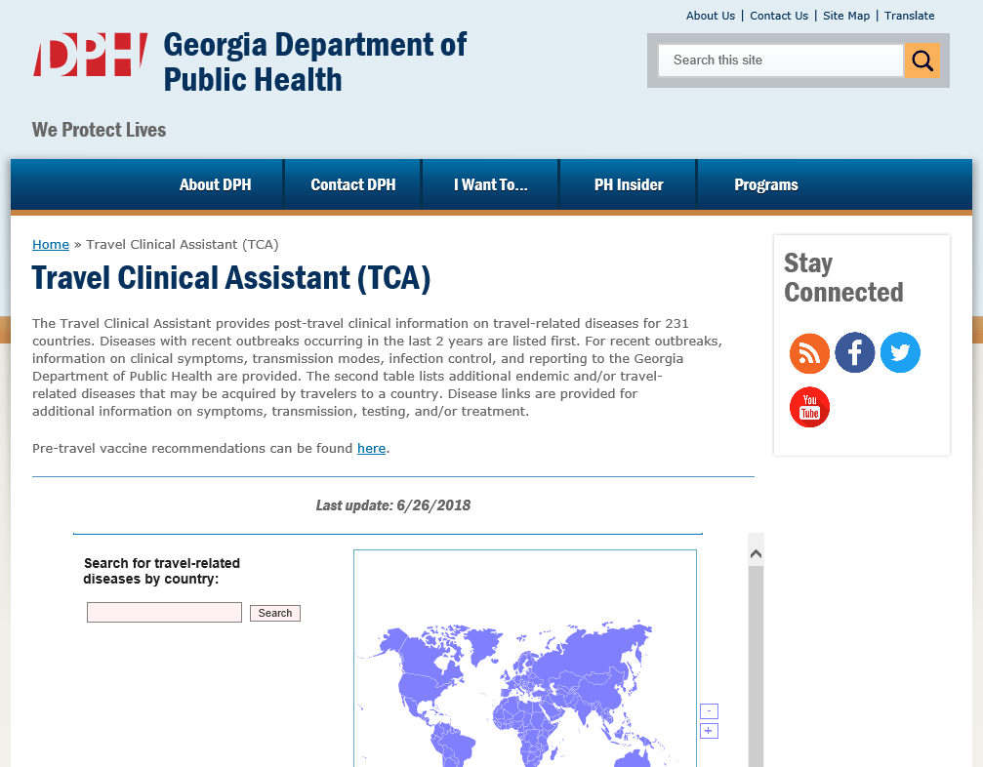
Travel Assessment Resources
CDC: Travel Health Notices (https://wwwnc.cdc.gov/travel/notices)
WHO: Disease Outbreak News (DONs) (https://www.who.int/csr/don/en/)
Georgia Department of Public Health: Travel Clinical Assistant (TCA) (https://dph.georgia.gov/TravelClinicalAssistant)

Slide 37
PPE videos: fun and short
Gloves
Gown
Facial Protection
Coming soon:
Updated Level 1 – HCID Full Barrier Precaution
Frontline facility simulation video

Slide 38
CDC Developed 2 Levels of PPE for Ebola
Clinically stable and does not have bleeding, vomiting, or diarrhea
Fluid resistant gown (ANSI/AAMI level 3)
Gloves that extend over the gown cuff (2 pairs for suspected viral hemorrhagic fever, 1 pair for viral respiratory pathogens)
Full face shield
Face mask
Clinically unstable or has bleeding, vomiting, or diarrhea
Impermeable gown (ANSI/AAMI level 4)
Gloves that extend over the gown cuff – 2 pairs
PAPR or N95
Boot covers to mid-calf
Cover all skin completely

Slide 39
Can Apply Ebola PPE Levels for other HCID
HCID Full Barrier Level 1:
For suspected viral respiratory pathogens or viral hemorrhagic fevers (VHF) who are clinically stable and do not have bleeding, vomiting, or diarrhea
Fluid resistant gown (ANSI/AAMI level 3)
Gloves that extend over the gown cuff (2 pairs for suspected viral hemorrhagic fever, 1 pair for viral respiratory pathogens)
Full face shield
N95 or PAPR preferred, can use regular face mask for VHF if no access to respirators
Booties and hair cover optional
HCID Full Barrier Level 2:
For VHF who is clinically unstable or has bleeding, vomiting, or diarrhea or a case of pox virus (monkeypox, smallpox)
Impermeable gown (ANSI/AAMI level 4)
Gloves that extend over the gown cuff - 2 pairs
PAPR or N95
Boot covers to mid-calf
Cover all skin completely

Slide 40
HCID Full Barrier Precautions Level 2
Fluid resistant gown (ANSI/AAMI level 3)
Gloves that extend over the gown cuff
2 pairs for suspected viral hemorrhagic fever
1 pair for viral respiratory pathogens
Full face shield
N95 or PAPR preferred, can use regular face mask for VHF if no access to respirators
Booties and hair cover optional

Slide 41
HCID Full Barrier Precautions Level 2 - Options
Staff wear scrubs
Operating room impervious gown
Operating room hood cover for neck
Face shield to cover face
N95 or PAPR (with shroud)
Knee high disposable boots
Hazardous materials jump suit
Face shield to cover face
N95 or PAPR (with shroud)

Slide 42
HCID Toolbox: Exercise Tools

Slide 43
Then Move to the Exercises
Seminars
Workshops
Table Top Exercises
Games
Drills and Mini-drills
Functional Exercises
Full Scale Exercises
Notes:
Building-Block Approach to Exercise Scheduling
As the level of training complexity increases staff capabilities increase
In order of building: Seminars, workshops, tabletop exercises, games, drills, functional exercises, full-scale exercises

Slide 44
Determine Time Required
Action | Estimated Time in minutes
Time to plan the exercise | <20 minutes
Time to obtain and train players: patient, observer, moderator | <20 minutes
Time to perform Hotwash, fill out after action report, identify strengths and weaknesses (5 whys), list opportunities for improvement | <20 minutes

Slide 45
Use One Page Simple Form
Use for mini-drill
Use for real life occurrence
Use prepared exercises provided online, modify the prepared exercises or make your own with the blank template

Slide 46
Exercise Scenario Templates Include
Identification and isolation MERS, Ebola, measles,
PPE - Protection of the airway, skin
Rule out MERS in the ED, what PPE do I need
Rule out MERS in the ED, what room do I put the patient in
Rule out Ebola in the ED, how do we collect and transport specimens
Rule out Ebola in the ED, how do we clean the environment
Rule out Ebola in the ED, who do we notify first
Rule out Ebola in the ED, where is the PPE and do we have enough, how do we get more
Rule out Ebola in the ED, what do we do with the waste
Game for donning and doffing PPE

Slide 47
Fill Out the Top Portion

Slide 48
Facility Can:
Use sample MSEL or
Modify sample or
Create a new one

Slide 49
Complete the Rest of the Elements

Slide 50
After Scenario
Perform hotwash immediately
Fill out the After Action Report on the bottom of the exercise form
Strengths
Opportunities for improvement – ask the 5 whys
Try to find the root cause of a problem by asking and answering “why” five times
List the planned improvement actions; later document their completion
Regulators will be looking for implementation of actions related to improvement opportunities identified in the drill or real life scenarios
Reward the players with candy and participation certificates

Slide 51
HCID Toolbox: Readiness Binder

Slide 52
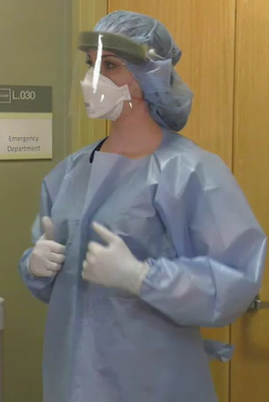
Make a High Consequence Infectious Disease Readiness Binder
Binder should be kept on unit – accessible to staff at point of care
Put the tools in plastic sleeves so can be taken out and used
Regularly update binders with current versions of document from MDH website
High Consequence Infectious Disease (HCID) Readiness Binder (https://www.health.state.mn.us/diseases/hcid/binder.html)
High Consequence Infectious Disease Readiness Binder

Slide 53
Binder Contents
HCID Readiness Binder Cover Sheet with Spine Insert
Table of Contents
HCID Screening Guidance
Pathogen Isolation Guide
Checklist for Arrival of Patient with a Suspected HCID
Level One and Level Two Full Barrier Isolation Door Signs
Instructions for Donning and Doffing of Level One and Level Two Full Barrier PPE (N95 version, PAPR version)
PPE Volume List for Level One Full Barrier Precautions (determine # of kits needed for 24-hour period)
List of Personnel Potentially Exposed to Patient with HCID (hang at room entrance)
List of Facility Personnel Trained to Manage HCID
Preparing Category A Lab Specimens for Transport
Powered Air Purifying Respirator (PAPR) Management
How to Make a Temporary Negative Pressure Room
Category A Waste Disposal and Room Cleaning for a Frontline Hospital
Personal Protective Equipment Size and Brand Chart for Health Care Workers

Slide 54
HCID Screening Guidance tool is included in Readiness Binder

Slide 55
Pathogen Infectious Disease Isolation Guide

Slide 56
Checklist for Arrival of Patient with a Suspected High Consequence Infectious Disease (HCID)
Notes:
Checklist of the actions you should be taking.

Slide 57
Sample signs

Slide 58
Frontline Facilities: HCID Full Barrier Level 1
Recommended to have enough PPE to care for a HCID for at least 24 hours
Fluid resistant gown (ANSI/AAMI level 3)
Extended length gloves (2 pairs for suspect VHF)
Full face shield
N95 or PAPR, Use regular face mask for VHF if no access to respirators
Booties and hair cover available
Have PPE in variety of sizes to fit large and small (gloves and gowns)
Have supplies accessible to frontline staff
Train staff on regular basis – suggest at least annually
Designate at least 3 experts on HCID who can serve as resource

Slide 59
Frontline Facilities: HCID Full Barrier Level 2
Consider how Level 2 HCID Full Barrier Precautions (if needed) could be attained to completely cover all skin with products already used in facility
Operating room impervious gown - (ANSI/AAMI level 4)
2 pairs of gloves
Operating room hood to cover neck
Face shield to cover face
N95 or PAPR (with shroud)
Knee high disposable boots
All skin and personal clothing is covered
Train staff on regular basis – suggest at least annually
Designate at least 3 experts on HCID who can serve as resource

Slide 60
Samples of Donning and Doffing Instructions
MDH Toolbox – in Readiness Binder: Instructions for Donning and Doffing PPE
HCID Level 1 Full Barrier Isolation
Level Two 2 Barrier Isolation – N95 Respirator Option
Level Two 2 Barrier Isolation – PAPR Option
University of Nebraska Medical Center: Doffing Biological PPE - Ebola Patients (PDF) (https://app1.unmc.edu/nursing/heroes/pdf/vhfppe/doffingBiologicalPPE-EbolaPatients-8.5x11-CC-v1.01.pdf)
CDC: Guidance on Personal Protective Equipment (PPE) To Be Used By Healthcare Workers during Management of Patients with Confirmed Ebola or Persons under Investigation (PUIs) for Ebola who are Clinically Unstable or Have Bleeding, Vomiting, or Diarrhea in U.S. Hospitals, Including Procedures for Donning and Doffing PPE (https://www.cdc.gov/vhf/ebola/healthcare-us/ppe/guidance.html)

Slide 61
List of Personnel Potentially Exposed to Patient with High Consequence Infectious Disease (HCID)

Slide 62
List of Facility Personnel Trained to Manage High Consequence Infectious Disease (HCID)

Slide 63
Preparing Category A Lab Specimens for Transport
Specimens sent for Ebola testing must be shipped at refrigeration temperature.
https://www.cdc.gov/labs/BMBL.html (p. 336-342)
Notes:
Figure 1. A Category A UN Standard Triple Packaging
Watertight primary receptacle of glass, metal, or plastic (if multiple fragile primary receptacles are placed in a single secondary packaging, they must be either individually wrapped or separated to as to prevent contact between them) that holds the infectious substance with a leakproof seal closure.
Surrounded by absorbent packing material (for liquids), watertight secondary packaging and capped.
There should be a list of contents on the container.
There should be a rigid outer packaging, UN package certification mark, infectious substance label, proper shipping name and UN number, and shipper or consignee indentification.
This information is provided in the Biosafety in Microbiological and Biomedical Laboratories by the U.S. Department of Health and Human Services Public Health Service, Centers for Disease Control and Prevention, National Institutes of Health, HHS Public No. (CDC) 21-1112, Revised December 2009, page 340
www.cdc.gov/biosafety/publications/bmbl5/bmbl.pdf

Slide 64
Preparing Category B (any non Category A Specimen) Lab Specimens for Transport
Specimens sent for Ebola testing must be shipped at refrigeration temperature.
Notes:
Figure 2. A Category B Non-specification Triple Packaging
Infectious substance in primary receptacle that is leakproof or siftproof, secondary packaging leakproof or siftproof (e.g., sealed plastic bag or other intermediate packaging)
Surrounded by absorbent material.
All inside rigid outer packaging with cushion material.
Includes package mark and name and telephone number of a person responsible. (This information may instead be provided on a written document such as an air waybill)

Slide 65
Powered Air Purifying Respirator (PAPR)
Required
Medical evaluation
Training
Fit testing is not necessary
Store in an assessable location, charged and ready to use
Test to make sure it is working properly every time before use
Determine number of hoods needed. Keep stored with PAPR. Have reserve hoods on hand in a location known to staff
If PAPR is used in Contact Isolation, this necessitates disposal of the hood or cleaning it per manufacturer
Powered Air Purifying Respirator (PAPR) (https://www.health.state.mn.us/facilities/patientsafety/infectioncontrol/ppe/comp/papr.html)

Slide 66
MDH – Methods for Temporary Negative Pressure Room

Slide 67
Category A Waste Disposal and Room Cleaning
Waste
Meet with facility’s waste handler to develop a strategy to include in the facility’s Infectious Waste Management Plan
Hold until diagnosis is made
If waste is determined to be Category A waste, work with MDH and facility’s waste handler to determine course of action
Environmental Cleaning
Meet with Environmental Services leadership to develop a strategy to include in the facility’s Infectious Agent Response Plan
Hold cleaning until diagnosis is made
If diagnosis is a disease in which the waste is Category A, refer to the facility’s policy and work with MDH to manage the room and equipment cleaning

Slide 68
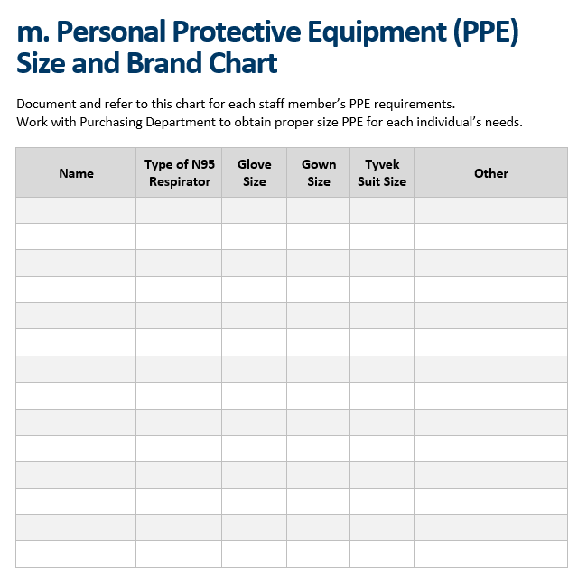
Document Sizes and Type of PPE for Each Individual

Slide 69
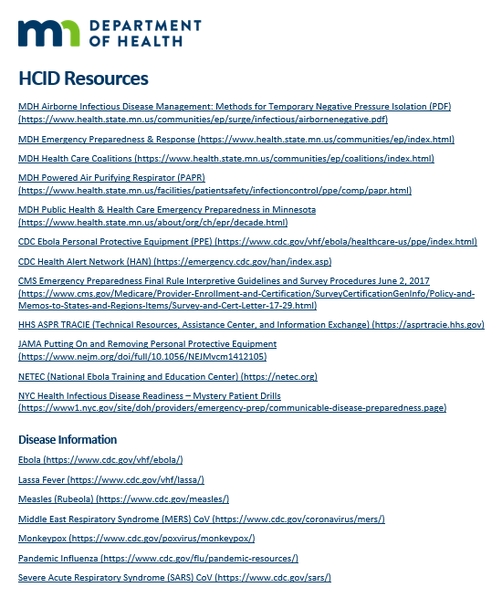
Additional HCID Resources

Slide 70
Toolbox Plans
Toolbox is a work in progress
Facilities can request individualized help from the MDH ICAR team health.icar@state.mn.us
We would like feedback and suggestions health.icar@state.mn.us

