Slide 1
Sexually Transmitted Infection (STI) Surveillance Report, 2023
Minnesota Department of Health STI Surveillance System

Slide 2
Introduction 1/2
Under Minnesota law, physicians and laboratories are required to report all laboratory-confirmed cases of chlamydia, gonorrhea, syphilis, and chancroid to the Minnesota Department of Health (MDH) within one working day.
The MDH does not maintain statistics for other, non-reportable STIs (ex: herpes, HPV/genital warts).
This slide set describes trends in reportable STIs in Minnesota by person, place, and time.
Analyses exclude cases reported from federal and private prisons.

Slide 3
Introduction 2/2
sti surveillance is the systematic collection of data from cases for the purpose of monitoring the frequency and distribution of STIs in a given population.
sti surveillance data are used to detect problems, prioritize resources, develop and target interventions, and evaluate the effectiveness of interventions.

Slide 4
Interpreting sti Surveillance Data (1/2)
Factors that impact the completeness and accuracy of sti data include:
  Level of sti screening by healthcare providers
  Individual test-seeking behavior
  Sensitivity of diagnostic tests
  Compliance with case reporting
  Completeness of case reporting
  Timeliness of case reporting
Increases and decreases in sti rates can be due to actual changes in disease occurrence and/or changes in one or more of the above factors.
COVID-19 lockdowns likely played a role in the number of cases reported/diagnosed during the COVID-19 pandemic years
Notes:
Factors that impact the completeness and accuracy of sti data include:
Level of sti screening by healthcare providers, individual test-seeking behavior, sensitivity of diagnostic tests, compliance with case reporting, completeness of case reporting, timeliness of case reporting.
Increases and decreases in sti rates can be due to actual changes in disease occurrence and/or changes in one or more of the above factors.
COVID-19 lockdowns likely played a role in the number of cases reported/diagnosed during the COVID-19 pandemic years

Slide 5
Interpreting sti Surveillance Data (2/2)
The surveillance system only includes cases with a positive laboratory test. Cases diagnosed solely on symptoms are not counted.
Since 2012 we have included cases that had only a lab report and no corresponding case report form. This has increased the number of unknowns in some variables.
In 2020, the COVID-19 response accelerated the use of laboratory reporting by facilities, again increasing the number of unknown variables.
Rate are computed using Census data. Census data uses weighted estimates to calculate intercensal estimates.
Surveillance data represent cases of infection, not individuals. A person with multiple infections in a given year will be counted more than once.
Caution is warranted when interpreting changes in sti numbers that can seem disproportionately large when the number of cases is small.

Slide 6
Census data updates
To better represent historical rates, historical census data and population estimates were used to calculate disease incidence rates.
Census data was used for 3 years intervals then sequential estimates are used for future years.
  2014-2016: Utilized 2014 census estimates published and released in 2021
  2017-2019: Utilized 2017 census estimates published and released in 2021
  2020-2022: Utilized 2020 census estimates published and released in 2021
  2023: Utilized 2022 estimates which published in June of 2023
Notes:
2014-2016 Single-Race Population Estimates 2010-2020 https://wonder.cdc.gov/Single-Race-v2020.HTML
2017-2019: Single-Race Population Estimates 2010-2020 https://wonder.cdc.gov/Single-Race-v2020.HTML
2020-2022: Single-Race Population Estimates 2020-2022 https://wonder.cdc.gov/Single-Race-v2022.HTML
2023: Single-Race Population Estimates 2020-2022 https://wonder.cdc.gov/Single-Race-v2022.HTML

Slide 7
National Context

Slide 8
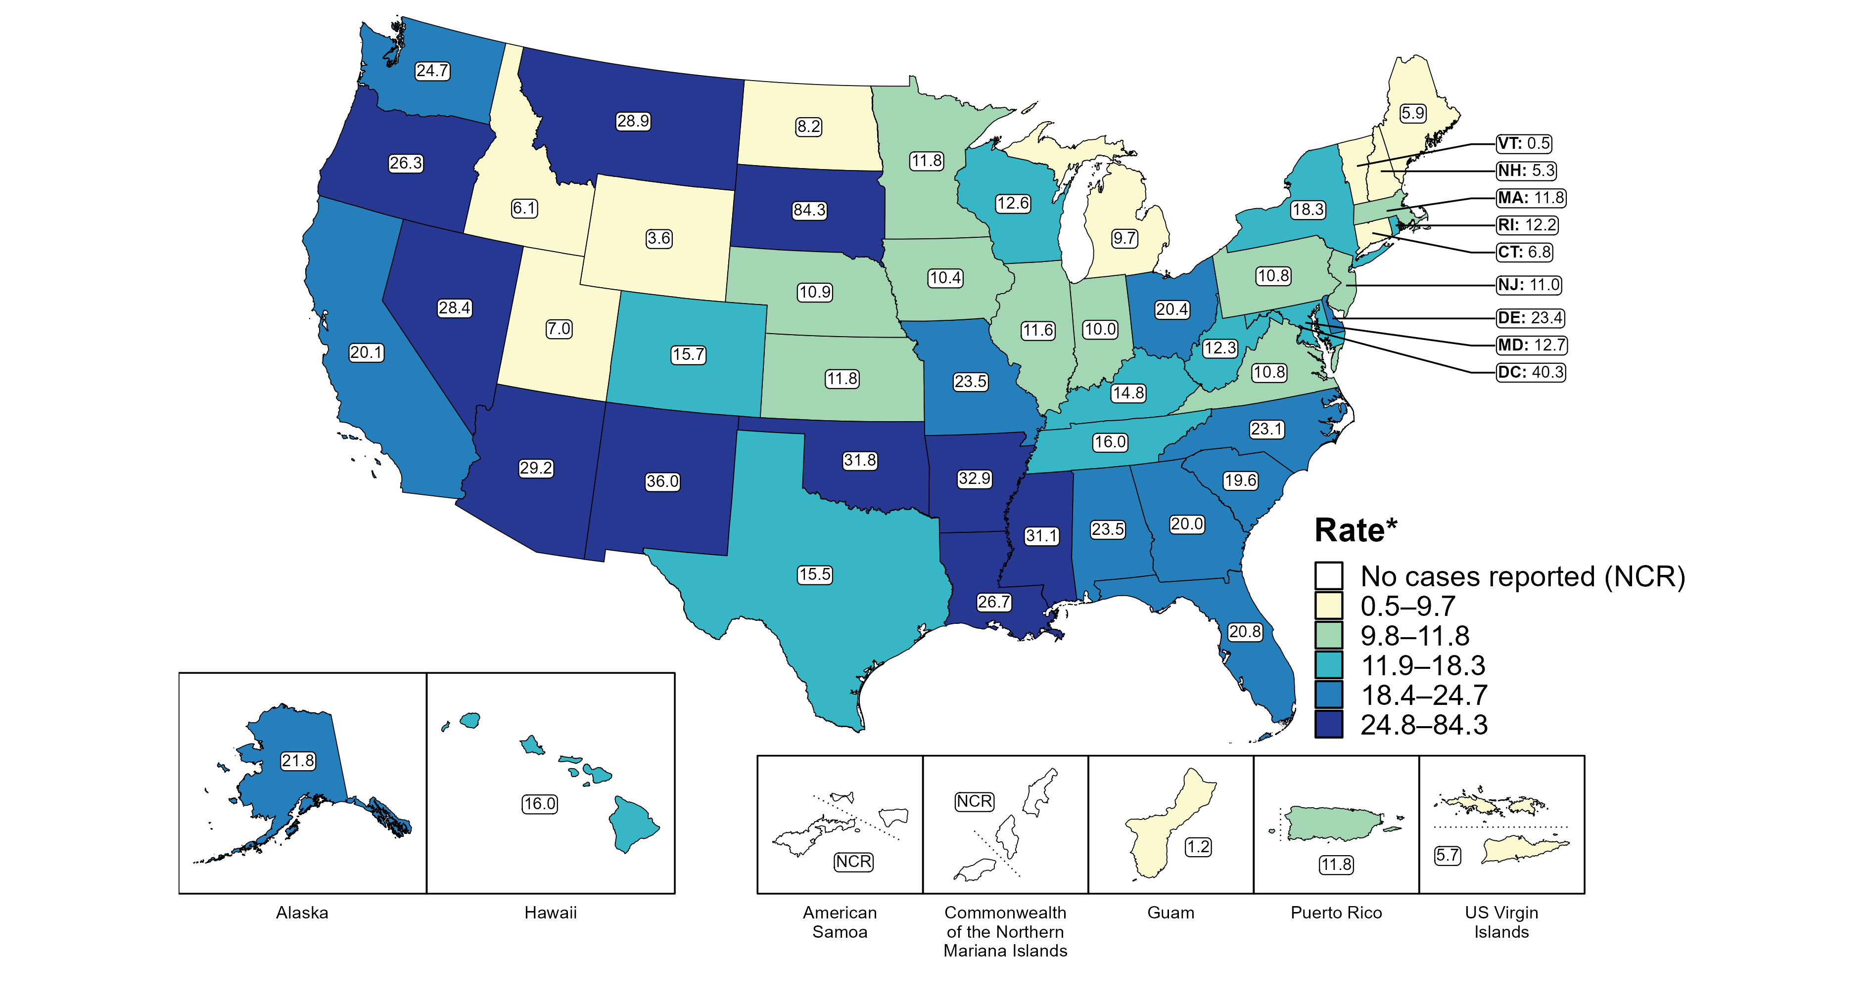
Primary and Secondary Syphilis — Rates of Reported Cases by Jurisdiction, United States and Territories, 2022
* Per 100,000
Notes:
In 2022, rates of reported primary and secondary (P&S) syphilis ranged by state from 0.5 cases per 100,000 population in Vermont to 84.3 cases per 100,000 population in South Dakota. The rate of reported P&S syphilis in the District of Columbia was 40.3 per 100,000 population.
Among US territories reporting any cases, rates of reported P&S syphilis ranged from 1.2 cases per 100,000 population in Guam to 11.8 cases per 100,000 population in Puerto Rico. No cases of P&S syphilis were reported in American Samoa and the Commonwealth of the Northern Mariana Islands.
This report includes data from years that coincide with the COVID-19 pandemic, which introduced uncertainty and difficulty in interpreting STI surveillance data. See Impact of COVID-19 on STIs for more information.
See Technical Notes (https://www.cdc.gov/sti/statistics/2022/technical-notes.htm) for information on syphilis case reporting and on interpreting reported rates in US territories.
Data for all figures are available at https://www.cdc.gov/sti/statistics/2022/data.zip. The file “PS Syphilis - Rates by Jurisdiction (US and Terr 2022).xlsx” contains the data for the figure presented on this slide.

Slide 9
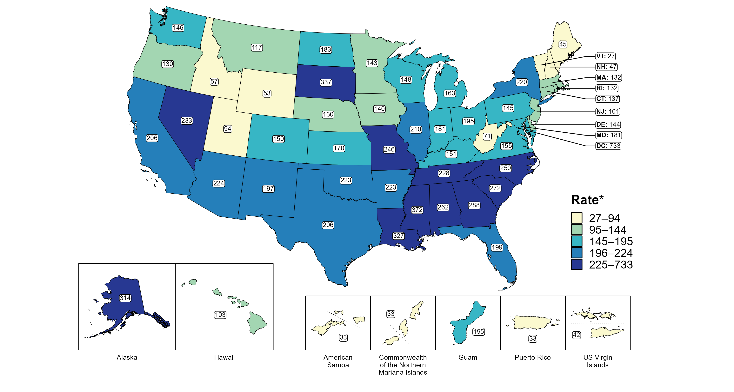
Gonorrhea — Rates of Reported Cases by Jurisdiction, United States and Territories, 2022
* Per 100,000
Notes:
In 2022, rates of reported gonorrhea ranged by state from 27 cases per 100,000 population in Vermont to 372 cases per 100,000 population in Mississippi. The rate of reported gonorrhea in the District of Columbia was 733 per 100,000 population.
Among US territories, rates of reported gonorrhea ranged from 33 cases per 100,000 population in American Samoa, the Commonwealth of the Northern Mariana Islands, and Puerto Rico to 195 cases per 100,000 population in Guam.
This report includes data from years that coincide with the COVID-19 pandemic, which introduced uncertainty and difficulty in interpreting STI surveillance data. See Impact of COVID-19 on STIs for more information.
See Technical Notes (https://www.cdc.gov/sti/statistics/2022/technical-notes.htm) for information on gonorrhea case reporting and on interpreting reported rates in US territories.
Data for all figures are available at https://www.cdc.gov/sti/statistics/2022/data.zip. The file “GC - Rates by Jurisdiction (US and Terr 2022).xlsx” contains the data for the figure presented on this slide.

Slide 10
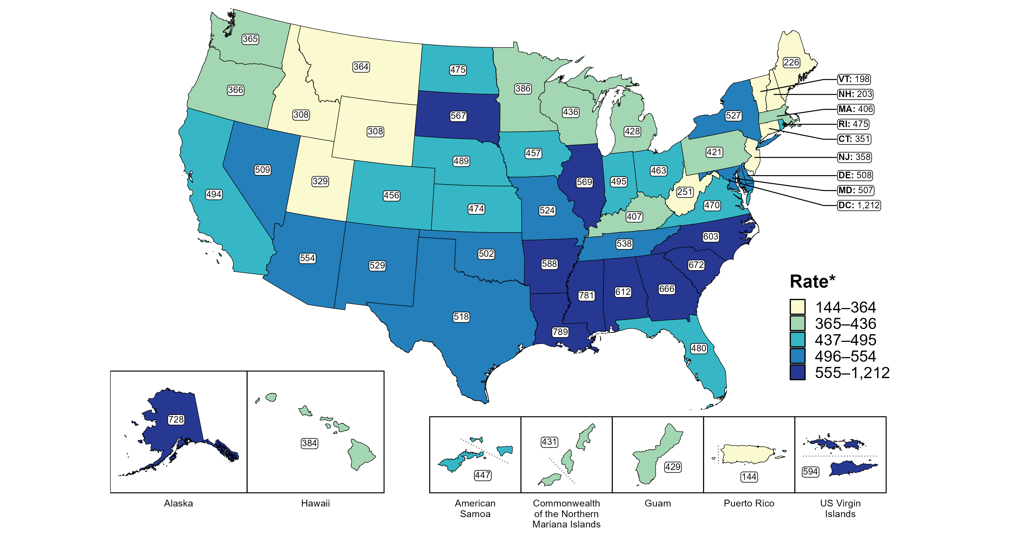
Chlamydia — Rates of Reported Cases by Jurisdiction, United States and Territories, 2022
* Per 100,000
Notes:
In 2022, rates of reported chlamydia ranged by state from 198 cases per 100,000 population in Vermont to 789 cases per 100,000 population in Louisiana. The rate of reported chlamydia in the District of Columbia was 1,212 per 100,000 population.
Among US territories, rates of reported chlamydia ranged from 144 cases per 100,000 population in Puerto Rico to 594 cases per 100,000 population in the US Virgin Islands.
This report includes data from years that coincide with the COVID-19 pandemic, which introduced uncertainty and difficulty in interpreting STI surveillance data. See Impact of COVID-19 on STIs for more information.
See Technical Notes (https://www.cdc.gov/sti/statistics/2022/technical-notes.htm) for information on chlamydia case reporting and on interpreting reported rates in US territories.
Data for all figures are available at https://www.cdc.gov/sti/statistics/2022/data.zip. The file “CT - Rates by Jurisdiction (US and Terr 2022).xlsx” contains the data for the figure presented on this slide.

Slide 11
Overview of STIs in Minnesota
Minnesota Department of Health sti Surveillance System

Slide 12
STIs in Minnesota:
Number of Cases Reported in 2022
Total of 31,256 sti cases reported to MDH in 2023:
  21,767 Chlamydia cases
  7,717 Gonorrhea cases
  1762 Syphilis cases (all stages)
  0 Chancroid cases
Notes:
In the year 2023, a total of 32,071 sti cases were reported to the Minnesota Department of Health:
21,167 Chlamydia cases
7717 Gonorrhea cases
1831 Syphilis cases (all stages)
0 Chancroid cases

Slide 13
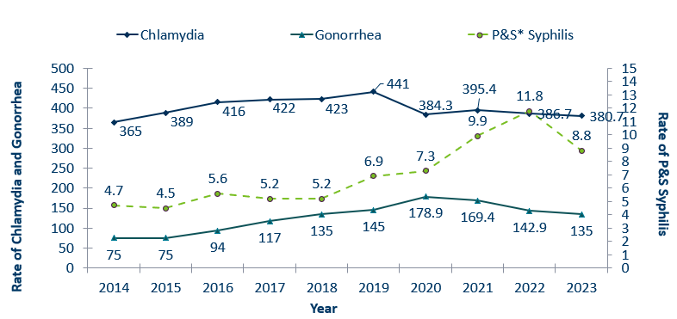
STIs in Minnesota:
Rate per 100,000 by Year of Diagnosis, 2014-2023
 | 2014 | 2015 | 2016 | 2017 | 2018 | 2019 | 2020 | 2021 | 2022 | 2023
Chlamydia | 365 | 389 | 416 | 422 | 423 | 441 | 384.3 | 395.4 | 386.7 | 380.7
Gonorrhea | 75 | 75 | 94 | 117 | 135 | 145 | 178.9 | 169.4 | 142.9 | 135
P&S* Syphilis | 4.7 | 4.5 | 5.6 | 5.2 | 5.2 | 6.9 | 7.3 | 9.9 | 11.8 | 8.8
* P&S = Primary and Secondary
Notes:
The rate of chlamydia in MN decreased by 1.6% to 380 per 100,000 compared to 386.7 per 100,000 in 2022.
The rate of gonorrhea in MN decreased 5% to 135 per 100,000 compared to 142.9 per 100,000 in 2022.
The rate of primary and secondary syphilis decreased by 25% from 11.8 in 2022 to 8.8 per 100,000 in 2022.

Slide 14
Syphilis
Minnesota Department of Health sti Surveillance System

Slide 15
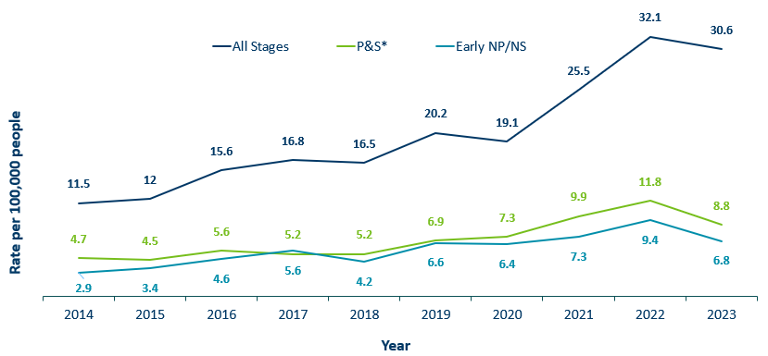
Syphilis Rates by Stage of Diagnosis, Minnesota, 2014-2023
 | 2014 | 2015 | 2016 | 2017 | 2018 | 2019 | 2020 | 2021 | 2022 | 2023
All Stages | 11.5 | 12 | 15.6 | 16.8 | 16.5 | 20.2 | 19.1 | 25.5 | 32.1 | 30.6
P&S* | 4.7 | 4.5 | 5.6 | 5.2 | 5.2 | 6.9 | 7.3 | 9.9 | 11.8 | 8.8
Early NP/NS | 2.9 | 3.4 | 4.6 | 5.6 | 4.2 | 6.6 | 6.4 | 7.3 | 9.4 | 6.8
* P&S = Primary and Secondary
Notes:
The overall syphilis rate is 30.8 per 100,000. A 4% decrease from 2022, and a 180% increase from a decade ago.
Of concern is the rate of primary and secondary syphilis which is 8.8 per 100,000, a 84% increase from 2014 a decade ago.

Slide 16
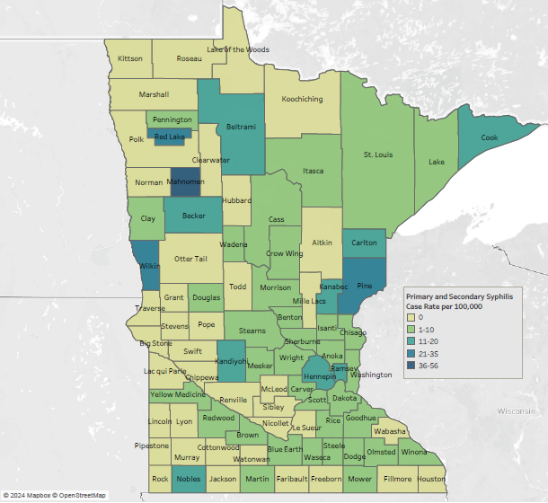
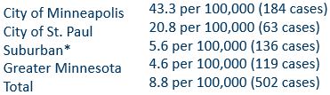
2023 Minnesota Primary & Secondary Syphilis Rates by County
*7-county metro area, excluding the cities of Minneapolis and St. Paul
Notes:
The statewide rate of primary and secondary syphilis decreased to 8.8 cases per 100,000 from 10.6.
Within the metro, the highest rate of primary and secondary syphilis remains in the City of Minneapolis at 43.3 cases per 100,000 population.
The City of St. Paul has the second highest rate in the metro at 20.8 per 100,000.
Data:
City of Minneapolis: 43.3 per 100,000 (184 cases)
City of St. Paul: 20.8 per 100,000 (63 cases)
Suburban*: 5.6 per 100,000 (136 cases)
Greater Minnesota: 4.6 per 100,000 (119 cases)
Total: 8.8 per 100,000 (502 cases)

Slide 17
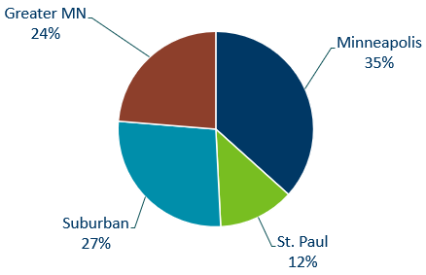
Primary & Secondary Syphilis Infections by Residence at Diagnosis
Minnesota, 2023
Total Number of Cases = 502
Suburban = Seven-county metro area including Anoka, Carver, Dakota, Hennepin (excluding Minneapolis), Ramsey (excluding St. Paul), Scott, and Washington counties. Greater MN = All other Minnesota counties outside the seven-county metro area.
Notes:
The City of Minneapolis had the largest percent of all reported primary and secondary cases with 35%
Second to Suburban MN with 27 % of the cases.
Third largest was Greater MN with 24%
St. Paul Reported 12%.

Slide 18
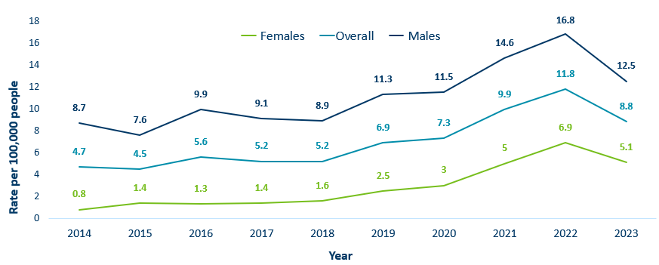
Primary & Secondary Syphilis Rates by Gender, Minnesota, 2014-2023
 | 2014 | 2015 | 2016 | 2017 | 2018 | 2019 | 2020 | 2021 | 2022 | 2023
Males | 8.7 | 7.6 | 9.9 | 9.1 | 8.9 | 11.3 | 11.5 | 14.6 | 16.8 | 12.5
Females | 0.8 | 1.4 | 1.3 | 1.4 | 1.6 | 2.5 | 3 | 5 | 6.9 | 5.1
Overall | 4.7 | 4.5 | 5.6 | 5.2 | 5.2 | 6.9 | 7.3 | 9.9 | 11.8 | 8.8
Notes:
Males have the highest rates of primary and secondary syphilis at 12.5 cases per 100,0000 population
The rate of primary and secondary syphilis in females is 5.1 per 100,000 per population.

Slide 19
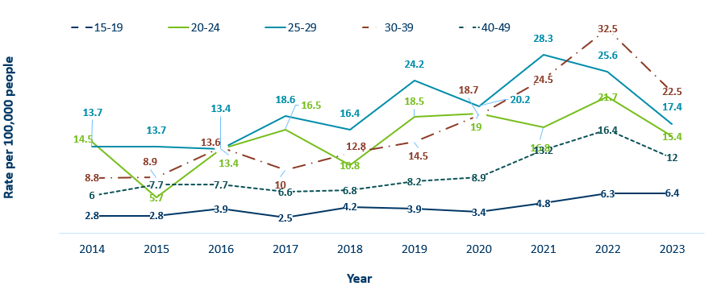
Primary & Secondary Syphilis Rates by Age
Minnesota, 2014-2023
 | 2014 | 2015 | 2016 | 2017 | 2018 | 2019 | 2020 | 2021 | 2022 | 2023
15-19 | 2.8 | 2.8 | 3.9 | 2.5 | 4.2 | 3.9 | 3.4 | 4.8 | 6.3 | 6.4
20-24 | 14.5 | 5.7 | 13.4 | 16.5 | 10.8 | 18.5 | 19 | 16.8 | 21.7 | 15.4
25-29 | 13.7 | 13.7 | 13.4 | 18.6 | 16.4 | 24.2 | 20.2 | 28.3 | 25.6 | 17.4
30-39 | 8.8 | 8.9 | 13.6 | 10 | 12.8 | 14.5 | 18.7 | 24.5 | 32.5 | 22.5
40-49 | 6 | 7.7 | 7.7 | 6.6 | 6.8 | 8.2 | 8.9 | 13.2 | 16.4 | 12
Notes:
The highest rates of primary and secondary syphilis were in the 30-39 year old age group at 22.5 cases per 100,000 population, a 31% decrease from 2022.
25-29 year olds and 20-24 had the next highest rate at 17.4 and 15.4 per 100,000, respectively.

Slide 20
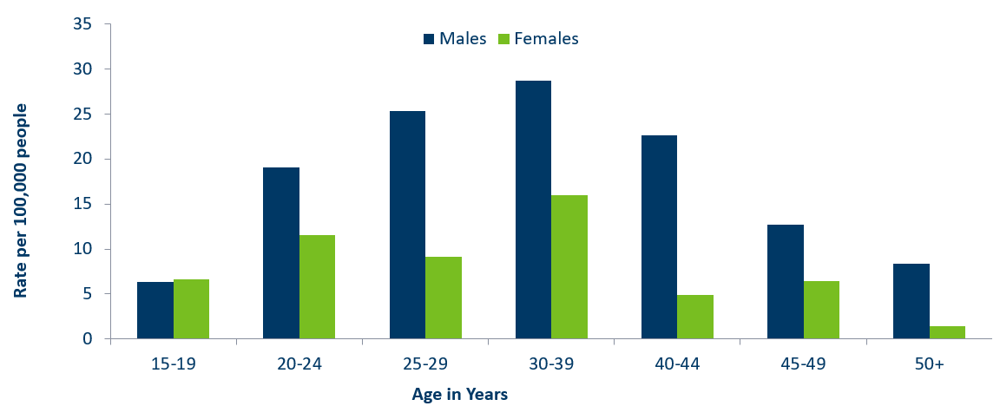
Age-Specific Primary & Secondary Syphilis Rates by Gender, Minnesota, 2023
 | 15-19 | 20-24 | 25-29 | 30-39 | 40-44 | 45-49 | 50+
Males | 6.3 | 19.1 | 25.3 | 28.7 | 22.6 | 12.7 | 8.4
Females | 6.6 | 11.5 | 9.1 | 16 | 4.9 | 6.4 | 1.4
Notes:
Males have higher rates of primary and secondary syphilis than females in all age groups. The rate in males is 2.5 times higher than females.
30-39 year old males had the highest rate at 28.7 per 100,000
30-39 year old females had the highest rate of the female population at 16 per 100,000.

Slide 21
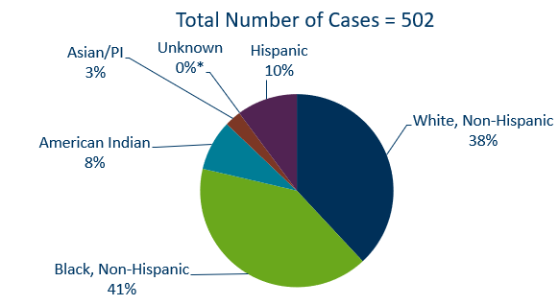
Primary & Secondary Syphilis Cases by Race
Minnesota, 2023
*Includes people reported with more than one race
Notes:
38% percent of all primary and secondary syphilis cases are White, non-Hispanic.
Black, non-Hispanic cases made up 41% of all Primary and Secondary Syphilis cases followed by, American Indian cases at 8%, Hispanic cases at 10%, and Asian/Pacific Islander cases at 3%.
Data:
Total number of cases=502
Asian/PI: 3%
American Indian: 8%
Black, non-Hispanic: 41%
White, non-Hispanic: 38%
Hispanic: 10%
Unknown: 0%*

Slide 22
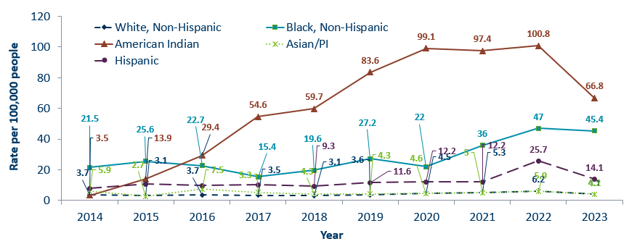
Primary & Secondary Syphilis Rates by Race/Ethnicity
Minnesota, 2014-2023
 | 2014 | 2015 | 2016 | 2017 | 2018 | 2019 | 2020 | 2021 | 2022 | 2023
White, Non-Hispanic | 3.7 | 3.1 | 3.7 | 3.5 | 3.1 | 3.6 | 4.5 | 5.3 | 6.2 | 4.1
Black, Non-Hispanic | 21.5 | 25.6 | 22.7 | 15.4 | 19.6 | 27.2 | 22 | 36 | 47 | 45.4
American Indian | 3.5 | 13.9 | 29.4 | 54.6 | 59.7 | 83.6 | 99.1 | 97.4 | 100.8 | 66.8
Asian/PI | 5.9 | 2.7 | 7.5 | 5.3 | 4.3 | 4.3 | 4.6 | 5 | 5.9 | 4.2
Hispanic | 7.9 | 10.8 | 9.8 | 10.3 | 9.3 | 11.6 | 12.2 | 12.2 | 25.7 | 14.1
* people of Hispanic ethnicity can be of any race.
Notes:
Large disparities continue to exist in the rates of syphilis compared to the White, non-Hispanic population.
The rates of primary and secondary syphilis are 16.5 times higher in the American Indian populations than that of the White, non-Hispanic population.
The rates of primary and secondary syphilis are 11.2 times higher in the Black/African American, non-Hispanic than that of the White, non-Hispanic population.
The rates of primary and secondary syphilis in the American Indian population are 66.8 per 100,000 compared to 4.1 per 100,000 in the White, non-Hispanic population.
The rates of primary and secondary syphilis in the Black/African American, non-Hispanic population are 45.4 per 100,000 .
The rates in the Hispanic population are 14.1 per 100,000 which is 3.5 times higher than the White, non-Hispanic population.
The rates in the Asian/Pacific Islander population are 4.2 per 100,000 which is 1.0 times higher than the White, non-Hispanic population.

Slide 23
Topic of Interest: Syphilis Among
Females and Congenital Syphilis in Minnesota
Minnesota Department of Health sti Surveillance System
Notes:
Topic of Interest: Syphilis Among
Females and Congenital Syphilis in Minnesota

Slide 24
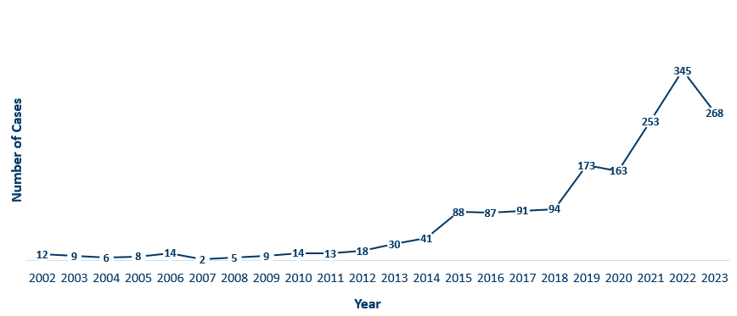
Female Early Syphilis Cases
Minnesota, 2023
Year | Cases
2002 | 12
2003 | 9
2004 | 6
2005 | 8
2006 | 14
2007 | 2
2008 | 5
2009 | 9
2010 | 14
2011 | 13
2012 | 18
2013 | 30
2014 | 41
2015 | 88
2016 | 87
2017 | 91
2018 | 94
2019 | 173
2020 | 163
2021 | 253
2022 | 345
2023 | 268
Notes:
The number of female early syphilis cases has increased dramatically over the last 10 years from 13 cases in 2011 to 345 in 2022 and 268 in 2023.
Increased 553% over the past 10 years

Slide 25
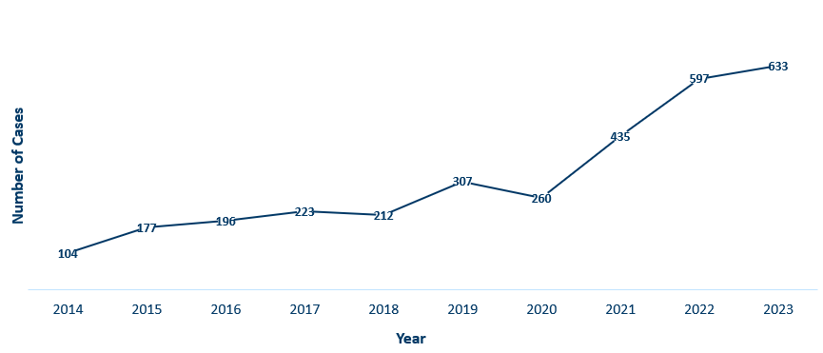
Female Syphilis Cases (All Stages)
Minnesota, 2023
Year | Cases
2014 | 104
2015 | 177
2016 | 196
2017 | 223
2018 | 212
2019 | 307
2020 | 260
2021 | 435
2022 | 597
2023 | 633
Notes:
Over the past 10 years total female syphilis cases have increased 508%

Slide 26
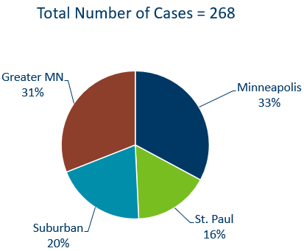
Early Syphilis Infections in Females by Residence at Diagnosis
Minnesota, 2023
Suburban = Seven-county metro area including Anoka, Carver, Dakota, Hennepin (excluding Minneapolis), Ramsey (excluding St. Paul), Scott, and Washington counties. Greater MN = All other Minnesota counties outside the seven-county metro area.
Notes:
31 percent of female early syphilis cases were residents of Greater Minnesota
20 percent of female early syphilis cases were residents of the Suburbs of the seven-county metro area
33 percent were City of Minneapolis residents, and 16 percent were St. Paul residents.

Slide 27
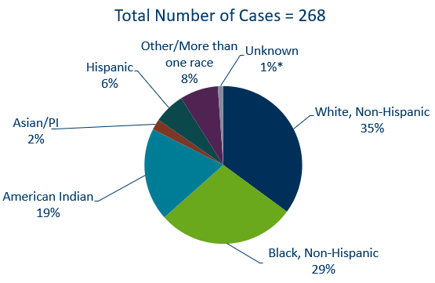
Early Syphilis Cases in Females by Race/Ethnicity
Minnesota, 2023
*Includes people reported with more than one race
Notes:
There are large disparities in women with syphilis. 19% of all early syphilis cases in females are found in the American Indian population and 29% in the Black, African American population.
Data:
White, non-Hispanic: 35%
Black, non-Hispanic: 29%
American Indian: 19%
Asian/PI: 2%
Hispanic: 6%
Other/more than one race: 8%

Slide 28
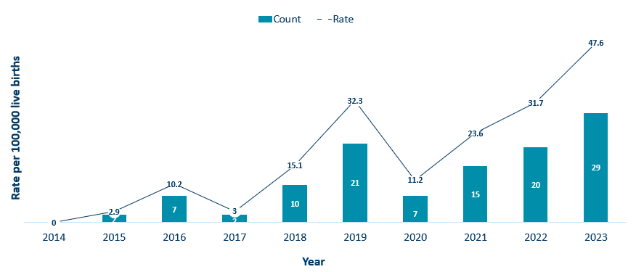
Congenital Syphilis Rates Among Infants
Minnesota, 2014-2023
Year | Rate | Count
2014 | 0 | 0
2015 | 2.9 | 2
2016 | 10.2 | 7
2017 | 3 | 2
2018 | 15.1 | 10
2019 | 32.3 | 21
2020 | 11.2 | 7
2021 | 23.6 | 15
2022 | 31.7 | 20
2023 | 47.6 | 29
Notes:
In Minnesota, the number and rate of congenital syphilis cases among infants has increased in 2023 compared to 2022. Overall, the rate has increased over the past five years from a rate of 32.3 per 100,000 live births in 2019 to 47.6 per 100,000 live births in 2023.
Syphilis may be passed from a pregnant person to the unborn baby through the placenta. The infection can cause miscarriages and stillbirths, and infants born with congenital syphilis can suffer a variety of serious health problems, including deformities, seizures, anemia and jaundice.
CDC reported that more than 3,700 congenital syphilis cases were reported in 2022, reflecting an alarming 937 percent increase in the past decade.

Slide 29
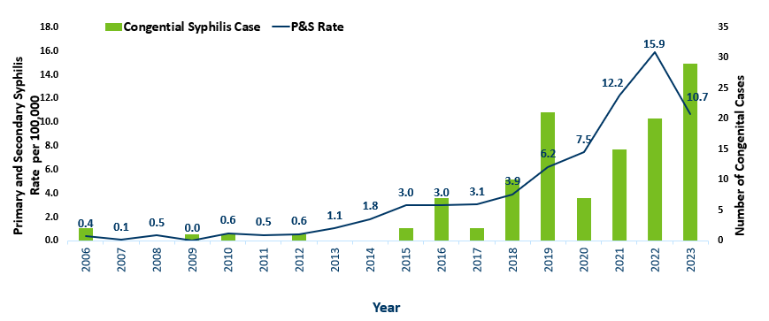
Primary and Secondary Syphilis Rates among Females aged 15-44 years and Number of Congenital Syphilis Cases – Minnesota, 2006-2023
Year | P&S Rate | Congential Syphilis Case
2006 | 0.4 | 2
2007 | 0.1 | 0
2008 | 0.5 | 0
2009 | 0.0 | 1
2010 | 0.6 | 1
2011 | 0.5 | 0
2012 | 0.6 | 1
2013 | 1.1 | 0
2014 | 1.8 | 0
2015 | 3.0 | 2
2016 | 3.0 | 7
2017 | 3.1 | 2
2018 | 3.9 | 10
2019 | 6.2 | 21
2020 | 7.5 | 7
2021 | 12.2 | 15
2022 | 15.9 | 20
2023 | 10.7 | 29
Notes:
Over the past decade syphilis has increased 1,275% among females aged 15-44

Slide 30
Topic of Interest: Early Syphilis Among
Men Who Have Sex With Men in Minnesota
Minnesota Department of Health sti Surveillance System
Notes:
Topic of Interest: Early Syphilis Among Men Who Have Sex With Men in Minnesota.
Men who have sex with men (MSM) make up the majority of the Male early syphilis cases.

Slide 31
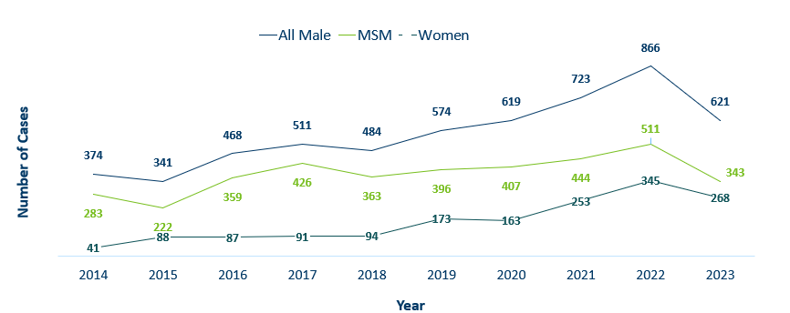
Number of Early Syphilis† Cases by Gender and MSM
Minnesota, 2014-2023
 | 2014 | 2015 | 2016 | 2017 | 2018 | 2019 | 2020 | 2021 | 2022 | 2023
All Male | 374 | 341 | 468 | 511 | 484 | 574 | 619 | 723 | 866 | 621
MSM | 283 | 222 | 359 | 426 | 363 | 396 | 407 | 444 | 511 | 343
Women | 41 | 88 | 87 | 91 | 94 | 173 | 163 | 253 | 345 | 268
MSM=Men who have sex with men.
Figure does not include cases diagnosed in transgender people
† Early Syphilis includes primary, secondary, and early latent stages of syphilis.
Notes:
Early syphilis, includes not only primary and secondary syphilis, but all new syphilis acquired in the past year.
Of all early syphilis cases, 69 percent were among people whose current gender was reported as male.
Men who have sex with men (MSM) account for 53% of all early syphilis cases among men.

Slide 32
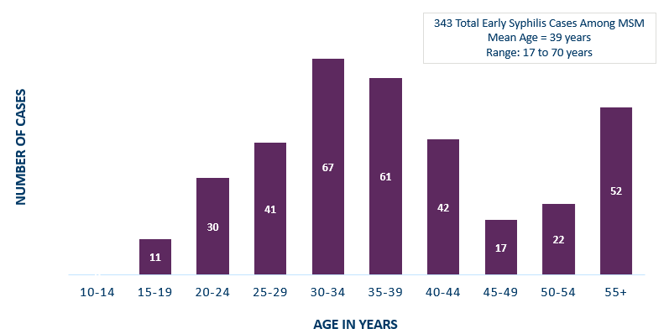
Early Syphilis† Cases Among MSM by Age
Minnesota, 2023
MSM=Men who have sex with men
† Early Syphilis includes primary, secondary, and early latent stages of syphilis.
Notes:
The average age of MSM with early syphilis is 39 years of age.
Ages ranged from 18–70 years of age
The 30-34 year old age group had the highest number of cases at 67
49% of early syphilis cases are among MSM are in the 25-39 age groups.
Data:
10-14: 0 cases
15-19: 11 cases
20-24: 30 cases
25-29: 41 cases
30-34: 67 cases
35-39: 61 cases
40-44: 41 cases
45-49: 17 cases
50-54: 22 cases
55+: 52 cases
343 total early syphilis cases among MSM
Mean age: 39 years
Range: 17-70 years

Slide 33
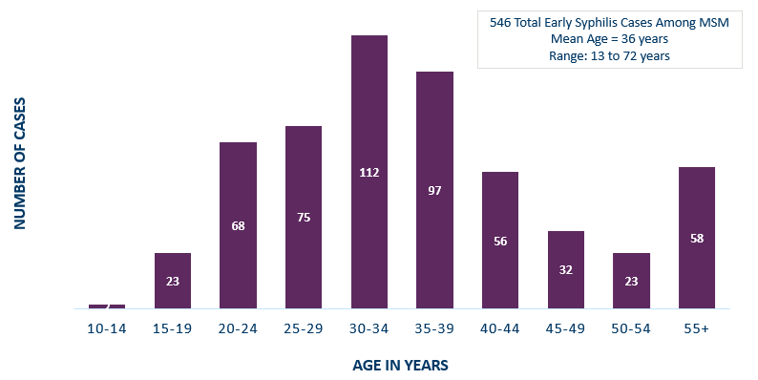
Early syphilis: Non-MSM cases
MSM=Men who have sex with men
† Early Syphilis includes primary, secondary, and early latent stages of syphilis.
Notes:
The average age of Early Non MSM with early syphilis is 36 years of age.
Ages ranged from 13–72 years of age
The 30-34 year old age group had the highest number of cases at 112
64% of early syphilis cases are among MSM are in the 25-39 age groups.
Data:
10-14: 2 cases
15-19: 23 cases
20-24: 68 cases
25-29: 75 cases
30-34: 112 cases
35-39: 97 cases
40-44: 56 cases
45-49: 32 cases
50-54: 23 cases
55+: 58 cases
546 total early syphilis cases among MSM
Mean age: 36 years
Range: 13-72 years

Slide 34
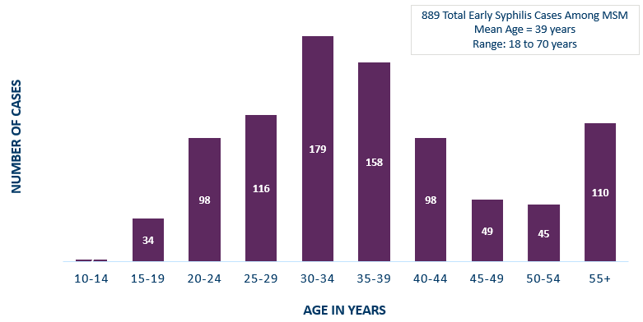
Early syphilis Age Non MSM
 | 10-14 | 15-19 | 20-24 | 25-29 | 30-34 | 35-39 | 40-44 | 45-49 | 50-54 | 55+
MSM | 2 | 34 | 98 | 116 | 179 | 158 | 98 | 49 | 45 | 110
MSM=Men who have sex with men
† Early Syphilis includes primary, secondary, and early latent stages of syphilis.
Notes:
The average age of MSM with early syphilis is 39 years of age.
Ages ranged from 18–70 years of age
The 30-34 year old age group had the highest number of cases at 65
49% of early syphilis cases are among MSM are in the 25-39 age groups.

Slide 35
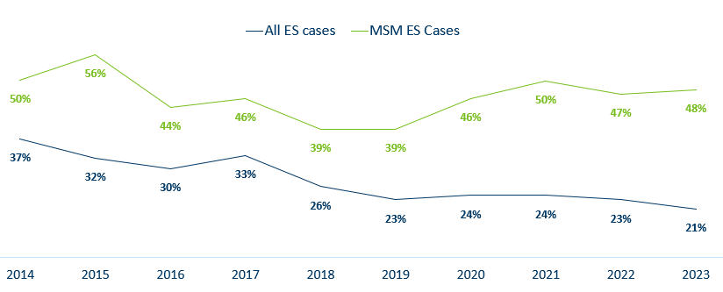
Early Syphilis† (ES) Cases
Co-infected with HIV, 2014-2023
 | 2014 | 2015 | 2016 | 2017 | 2018 | 2019 | 2020 | 2021 | 2022 | 2023
All ES cases | 37% | 32% | 30% | 33% | 26% | 23% | 24% | 24% | 23% | 21%
MSM ES Cases | 50% | 56% | 44% | 46% | 39% | 39% | 46% | 50% | 47% | 48%
MSM=Men who have sex with men
† Early Syphilis includes primary, secondary, and early latent stages of syphilis.
Notes:
18% percent of all early syphilis cases were co-infected with HIV.
49% percent of all MSM early syphilis cases were co-infected with HIV.

Slide 36
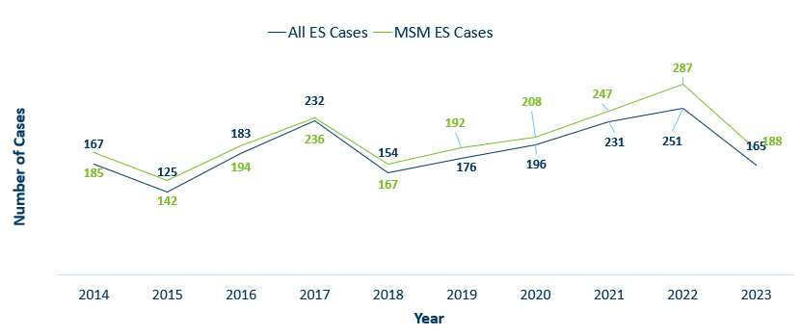
Number of Early Syphilis† Cases by Gender and MSM
Minnesota, 2014-2023
 | 2014 | 2015 | 2016 | 2017 | 2018 | 2019 | 2020 | 2021 | 2022 | 2023
All ES Cases | 167 | 125 | 183 | 232 | 154 | 176 | 196 | 231 | 251 | 165
MSM ES Cases | 185 | 142 | 194 | 236 | 167 | 192 | 208 | 247 | 287 | 188
MSM=Men who have sex with men.
Figure does not include cases diagnosed in transgender people
† Early Syphilis includes primary, secondary, and early latent stages of syphilis.
Notes:
Early syphilis, includes not only primary and secondary syphilis, but all new syphilis acquired in the past year.
Of all early syphilis cases, 69 percent were among people whose current gender was reported as male.
Men who have sex with men (MSM) account for 53% of all early syphilis cases among men.

Slide 37
Gonorrhea
Minnesota Department of Health sti Surveillance System
Notes:
Cases of reported gonorrhea saw the greatest decrease of 16 percent. 9,671 in 2021 compared to 8,161 in 2022.

Slide 38
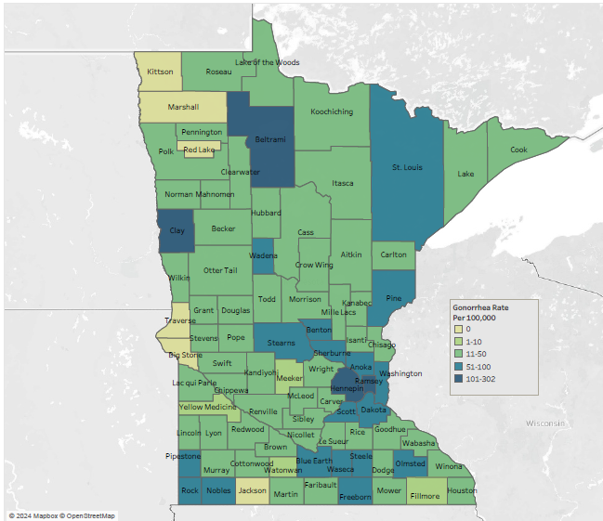
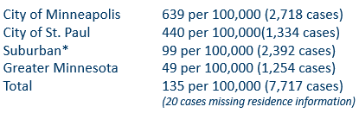
2023 Minnesota Gonorrhea Rates by County
*7-county metro area, excluding the cities of Minneapolis and St. Paul
Data: STD Surveillance Report Data Tables, Minnesota 2023 (PDF)
Notes:
The rate of gonorrhea in MN was 135 per 100,000. This is a rate decrease of 5% from 2022.
The city of Minneapolis continues to have the highest rates of gonorrhea at 639 per 100,000, followed by the city of St. Paul at 440 per 100,000, the suburban area (7-county metro excluding Minneapolis & St. Paul) at 99 per 100,000 and Greater Minnesota at 49 per 100,000.
The rates of gonorrhea decreased in all areas across Minnesota.

Slide 39
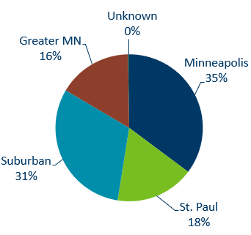
Gonorrhea Infections in Minnesota by Residence at Diagnosis, 2023
Suburban = Seven-county metro area including Anoka, Carver, Dakota, Hennepin (excluding Minneapolis), Ramsey (excluding St. Paul), Scott, and Washington counties. Greater MN = All other Minnesota counties outside the seven-county metro area.
Notes:
All parts of Minnesota are affected by gonorrhea. The cities of Minneapolis and St. Paul reported 48% of the cases; followed by 31% in the Suburban area surrounding the cities, and 16% in Greater Minnesota.

Slide 40
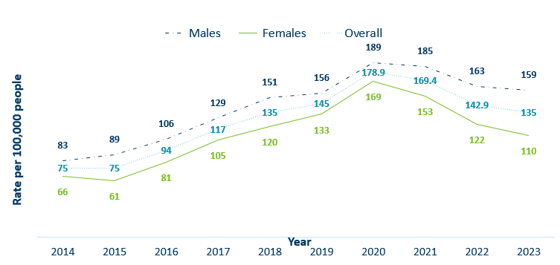
Gonorrhea Rates by Gender
Minnesota, 2014-2023
 | 2014 | 2015 | 2016 | 2017 | 2018 | 2019 | 2020 | 2021 | 2022 | 2023
Males | 83 | 89 | 106 | 129 | 151 | 156 | 189 | 185 | 163 | 159
Females | 66 | 61 | 81 | 105 | 120 | 133 | 169 | 153 | 122 | 110
Overall | 75 | 75 | 94 | 117 | 135 | 145 | 178.9 | 169.4 | 142.9 | 135
Notes:
The rates of gonorrhea went down in both males and females in 2023. Males continue to have higher rates of gonorrhea than females
Males had a rate of 159 per 100,000 which is a decrease of 2% over the 2022 rate of 163 per 100,000.
Females had a rate of 110 per 100,000 which is a decrease of 10% over the 2022 rate of 122 per 100,000.

Slide 41
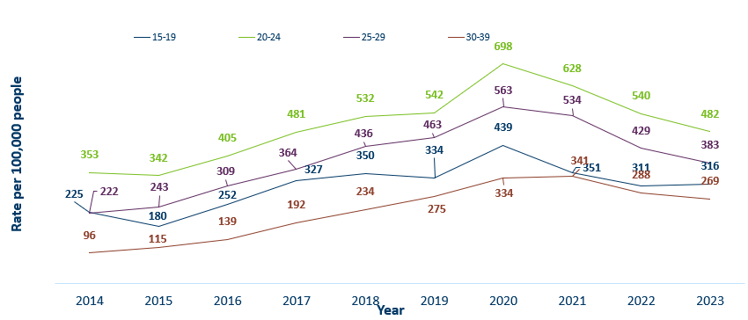
Gonorrhea Rates by Age
Minnesota, 2014-2023
 | 2014 | 2015 | 2016 | 2017 | 2018 | 2019 | 2020 | 2021 | 2022 | 2023
15-19 | 225 | 180 | 252 | 327 | 350 | 334 | 439 | 351 | 311 | 316
20-24 | 353 | 342 | 405 | 481 | 532 | 542 | 698 | 628 | 540 | 482
25-29 | 222 | 243 | 309 | 364 | 436 | 463 | 563 | 534 | 429 | 383
30-39 | 96 | 115 | 139 | 192 | 234 | 275 | 334 | 341 | 288 | 269
Notes:
All age groups saw a decrease in gonorrhea rates.
The highest rate remains in the 20–24-year-old age group at 482 per 100,000.

Slide 42
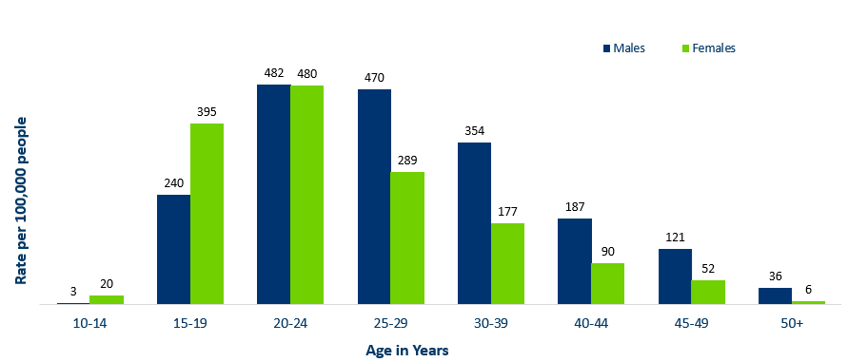
Age-Specific Gonorrhea Rates by Gender
Minnesota, 2023
 | 10-14 | 15-19 | 20-24 | 25-29 | 30-39 | 40-44 | 45-49 | 50+
Males | 3 | 240 | 482 | 470 | 354 | 187 | 121 | 36
Females | 20 | 395 | 480 | 289 | 177 | 90 | 52 | 6
Notes:
Females under the age of 25 years of age, continue to report the highest rates among females.
Males have the highest rate of both genders at 482 per 100,000 in the 20-24 year old age groups
Males continue to record the highest rate among age groups older than 25 years.

Slide 43
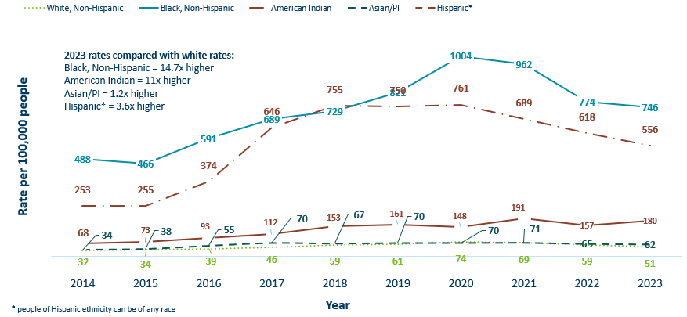
Gonorrhea Rates by Race/Ethnicity
Minnesota, 2014-2023
 | 2014 | 2015 | 2016 | 2017 | 2018 | 2019 | 2020 | 2021 | 2022 | 2023
White, Non-Hispanic | 32 | 34 | 39 | 46 | 59 | 61 | 74 | 69 | 59 | 51
Black, Non-Hispanic | 488 | 466 | 591 | 689 | 729 | 821 | 1004 | 962 | 774 | 746
American Indian | 253 | 255 | 374 | 646 | 755 | 750 | 761 | 689 | 618 | 556
Asian/PI | 34 | 38 | 55 | 70 | 67 | 70 | 70 | 71 | 65 | 62
Hispanic* | 68 | 73 | 93 | 112 | 153 | 161 | 148 | 191 | 157 | 180

Slide 44
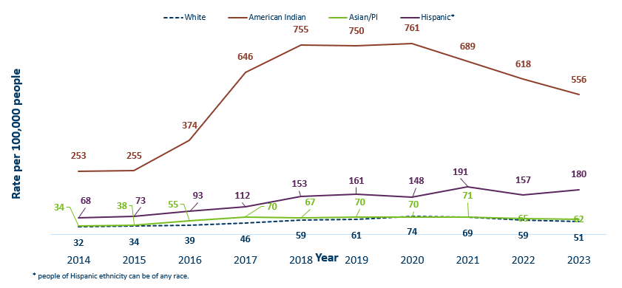
Gonorrhea Rates by Race/Ethnicity
Minnesota, 2012-2022
 | 2014 | 2015 | 2016 | 2017 | 2018 | 2019 | 2020 | 2021 | 2022 | 2023
White | 32 | 34 | 39 | 46 | 59 | 61 | 74 | 69 | 59 | 51
American Indian | 253 | 255 | 374 | 646 | 755 | 750 | 761 | 689 | 618 | 556
Asian/PI | 34 | 38 | 55 | 70 | 67 | 70 | 70 | 71 | 65 | 62
Hispanic* | 68 | 73 | 93 | 112 | 153 | 161 | 148 | 191 | 157 | 180
Notes:
This is a clearer view of the rates of Gonorrhea by Race/Ethnicity from the previous slide, after removing the Black/African American, Non-Hispanic data.

Slide 45
Chlamydia
Minnesota Department of Health STI Surveillance System
Notes:
Chlamydia decreased 2% in 2022 compared to 2021 which recorded the first decline in over a decade. This could be the result of a true decrease in the number of cases, but it could also reflect the COVID-19 pandemic and reduced preventative visits. Chlamydia is more likely to be asymptomatic than gonorrhea and syphilis, especially in females.

Slide 46
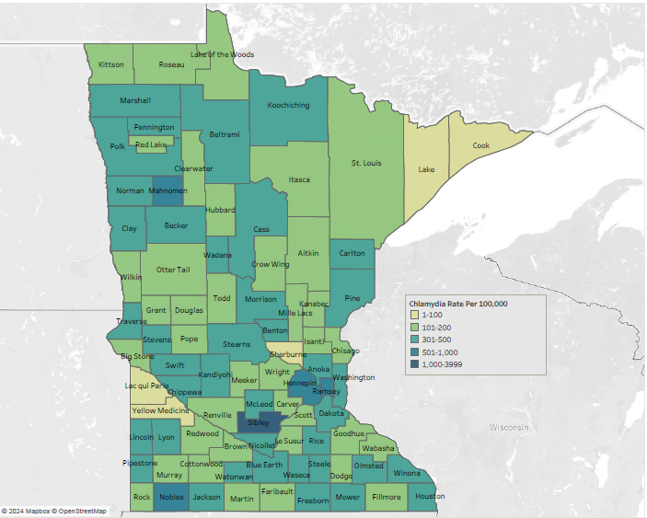
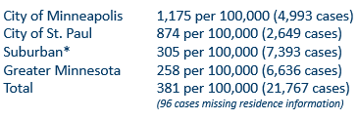
2023 Minnesota Chlamydia Rates by County
*7-county metro area, excluding the cities of Minneapolis and St. Paul
Data: STI Surveillance Report Data Tables, Minnesota 2023 (PDF)
Notes:
Despite the decrease, all counties in Minnesota were affected by chlamydia. There were at least 3 cases in all counties in 2023.
The city of Minneapolis continues to have the highest rates of chlamydia at 1,175 per 100,000, followed by the city of St. Paul at 874 per 100,000, the suburban area (7-county metro excluding Minneapolis & St. Paul) at 305 per 100,000 and Greater Minnesota at 259 per 100,000.

Slide 47
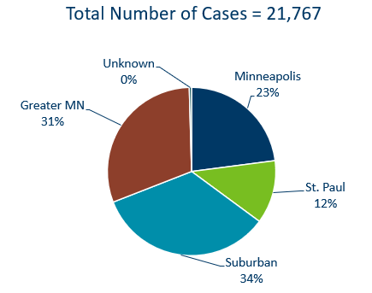
Chlamydia Infections by Residence at Diagnosis
Minnesota, 2023
Suburban = Seven-county metro area including Anoka, Carver, Dakota, Hennepin (excluding Minneapolis), Ramsey (excluding St. Paul), Scott, and Washington counties. Greater MN = All other Minnesota counties outside the seven-county metro area.
Notes:
All areas of Minnesota are affected by chlamydia. About a third of the cases occurred in the cities of Minneapolis and St. Paul, a third in the Suburban area surround the cities, and a third in Greater Minnesota.

Slide 48
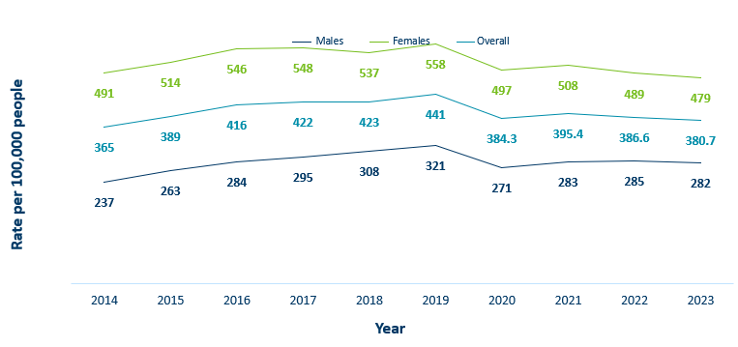
Chlamydia Rates by Gender
Minnesota, 2014-2023
 | 2014 | 2015 | 2016 | 2017 | 2018 | 2019 | 2020 | 2021 | 2022 | 2023
Males | 237 | 263 | 284 | 295 | 308 | 321 | 271 | 283 | 285 | 282
Females | 491 | 514 | 546 | 548 | 537 | 558 | 497 | 508 | 489 | 479
Overall | 365 | 389 | 416 | 422 | 423 | 441 | 384.3 | 395.4 | 386.6 | 380.7
Notes:
The rates of chlamydia decreased for both males and females in 2023.
Females continue to have higher rates of chlamydia than males.
Females had a rate of 479 per 100,000 which is a decrease of 8% from 2022 rate of 520 per 100,000.
Males had a rate of 282 per 100,000 which is a decrease of 9% over the 2022 rate of 311 per 100,000.

Slide 49
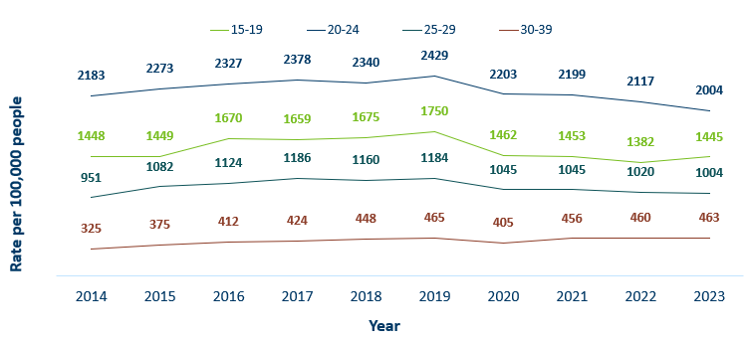
Chlamydia Rates by Age
Minnesota, 2014-2023
 | 2014 | 2015 | 2016 | 2017 | 2018 | 2019 | 2020 | 2021 | 2022 | 2023
15-19 | 1448 | 1449 | 1670 | 1659 | 1675 | 1750 | 1462 | 1453 | 1382 | 1445
20-24 | 2183 | 2273 | 2327 | 2378 | 2340 | 2429 | 2203 | 2199 | 2117 | 2004
25-29 | 951 | 1082 | 1124 | 1186 | 1160 | 1184 | 1045 | 1045 | 1020 | 1004
30-39 | 325 | 375 | 412 | 424 | 448 | 465 | 405 | 456 | 460 | 463
Notes:
The highest rate remains in the 20-24 year old age group at 2,004 per 100,000.
The next highest rate remains in the 15-19 year old age group at 1,445 per 100,000.

Slide 50
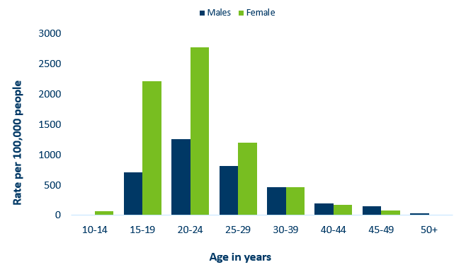
Age-Specific Chlamydia Rates by Gender,
Minnesota, 2023
Data: STI Surveillance Report Data Tables, Minnesota 2023 (PDF)
Notes:
The rates of Chlamydia are highest among females.
Females, 20-24 years of age continue to have the highest rate at 2771 per 100,000.
Males aged 30+ have higher rates than females in each respective age group.

Slide 51
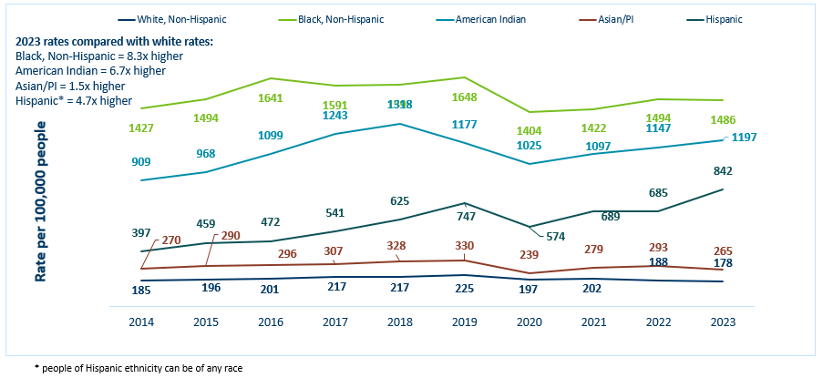
Chlamydia Rates by Race/Ethnicity Minnesota, 2014-2023 (1/2)
 | 2014 | 2015 | 2016 | 2017 | 2018 | 2019 | 2020 | 2021 | 2022 | 2023
White, Non-Hispanic | 185 | 196 | 201 | 217 | 217 | 225 | 197 | 202 | 188 | 178
Black, Non-Hispanic | 1427 | 1494 | 1641 | 1591 | 1595 | 1648 | 1404 | 1422 | 1494 | 1486
American Indian | 909 | 968 | 1099 | 1243 | 1318 | 1177 | 1025 | 1097 | 1147 | 1197
Asian/PI | 270 | 290 | 296 | 307 | 328 | 330 | 239 | 279 | 293 | 265
Hispanic | 397 | 459 | 472 | 541 | 625 | 747 | 574 | 689 | 685 | 842
Notes:
There continues to be great disparities in rates of chlamydia.
The Black/African American, non-Hispanic population has rates that are 8.3 times higher than that of white rates.
The rate in the Black/African American, non-Hispanic population was 1486 per 100,000 compared to the rate in the White, non-Hispanic population at 178 per 100,000.
The American Indian population had a rate that was 6.7 times higher at 1197 per 100,000
The Asian/Pacific Islander population had a rate that was 1.5 times higher at 265 per 100,000
The Hispanic/Latino population, which can be of any race, had a rate that was 4.7 times higher at 842 per 100,000

Slide 52
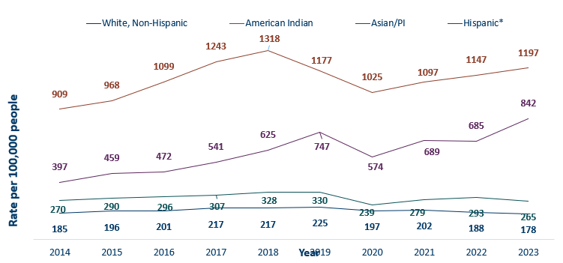
Chlamydia Rates by Race/Ethnicity, Minnesota, 2014-2023 (2/2)
 | 2014 | 2015 | 2016 | 2017 | 2018 | 2019 | 2020 | 2021 | 2022 | 2023
White, Non-Hispanic | 185 | 196 | 201 | 217 | 217 | 225 | 197 | 202 | 188 | 178
American Indian | 909 | 968 | 1099 | 1243 | 1318 | 1177 | 1025 | 1097 | 1147 | 1197
Asian/PI | 270 | 290 | 296 | 307 | 328 | 330 | 239 | 279 | 293 | 265
Hispanic* | 397 | 459 | 472 | 541 | 625 | 747 | 574 | 689 | 685 | 842
Notes:
This is a clearer view of the rates from the previous slide, removing the Black/African American, non-Hispanic data.

Slide 53
Chlamydia and Gonorrhea Among Adolescents and Young Adults
(15-24 years of age)
Minnesota Department of Health STI Surveillance System

Slide 54
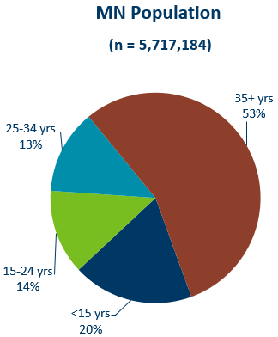
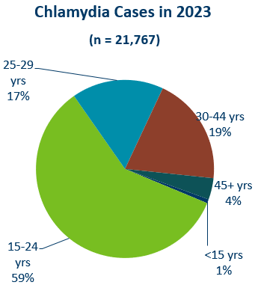
Chlamydia Disproportionately Impacts Youth and Young Adults*
Data: STI Surveillance Report Data Tables, Minnesota 2023 (PDF)
Notes:
Chlamydia continues to disproportionately impact youth and young adults.
15–24-year-olds make up only 14% of the population, but account for 59% of all chlamydia cases reported.
MN Population
N=5,717,184
<15 years: 20%
15-24: 14%
25-24: 13%
35+: 53%

Slide 55
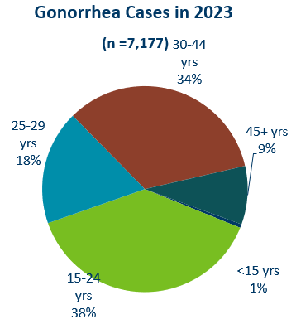
Gonorrhea Disproportionately Impacts Youth and Young Adults
Data: STI Surveillance Report Data Tables, Minnesota 2023 (PDF)
Notes:
Chlamydia continues to disproportionately impact youth and young adults.
15–24-year-olds make up only 14% of the population, but account for 59% of all chlamydia cases reported.
MN Population
N=5,717,184
<15 years: 20%
15-24: 14%
25-24: 13%
35+: 53%

Slide 56
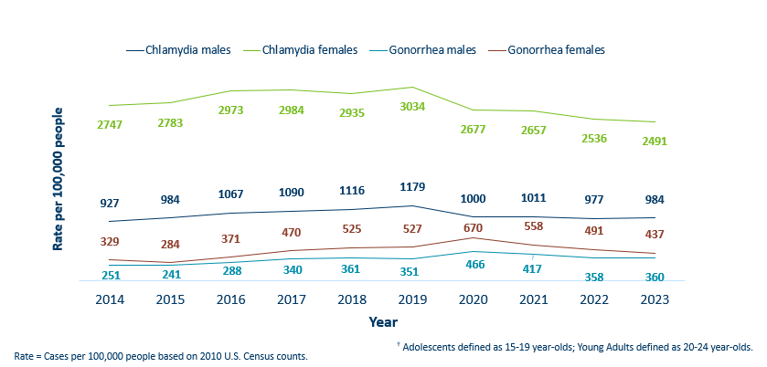
Chlamydia and Gonorrhea Rates Among Adolescents & Young Adults† by Gender in Minnesota, 2014-2023
 | 2014 | 2015 | 2016 | 2017 | 2018 | 2019 | 2020 | 2021 | 2022 | 2023
Chlamydia males | 927 | 984 | 1067 | 1090 | 1116 | 1179 | 1000 | 1011 | 977 | 984
Chlamydia females | 2747 | 2783 | 2973 | 2984 | 2935 | 3034 | 2677 | 2657 | 2536 | 2491
Gonorrhea males | 251 | 241 | 288 | 340 | 361 | 351 | 466 | 417 | 358 | 360
Gonorrhea females | 329 | 284 | 371 | 470 | 525 | 527 | 670 | 558 | 491 | 437
Notes:
The rates of chlamydia and gonorrhea are higher in females compared to males in the 15–24-year-old age group.
The rates for chlamydia in females are 2491 per 100,000 population compared to males at 984 per 100,000 population.
The rates of gonorrhea in females is 437 per 100,000 compared to 360 per 100,000 in males.

Slide 57
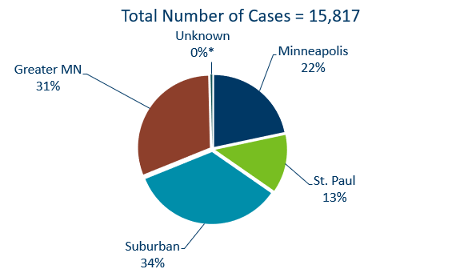
Geographic Characteristics of Adolescents and Young Adults † Diagnosed with Chlamydia or Gonorrhea, Minnesota 2023
Suburban = Seven-county metro area including Anoka, Carver, Dakota, Hennepin (excluding Minneapolis), Ramsey (excluding St. Paul), Scott, and Washington counties. Greater MN = All other Minnesota counties outside the seven-county metro area.
† Adolescents defined as 15-19 year-olds; Young Adults defined as 20-24 year-olds.
Notes:
In adolescents and young adults diagnosed with chlamydia or gonorrhea in 2023, about one-third (35%) reside in Minneapolis or St. Paul, one-third (31%) in Greater MN and one-third (34%) in the suburban seven-county metro region.

Slide 58
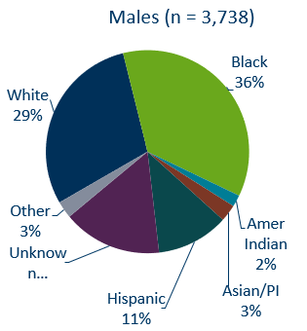
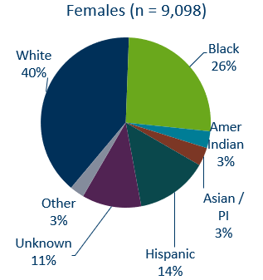
Chlamydia Cases Among Adolescents and Young Adults† by Gender and Race, Minnesota, 2023
† Adolescents defined as 15-19 year-olds; Young Adults defined as 20-24 year-olds
* Other is more than one race. Excludes 1 transgender person
Data: STI Surveillance Report Data Tables, Minnesota 2023 (PDF)

Slide 59
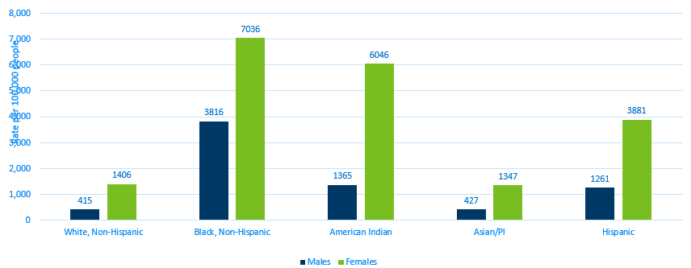
Chlamydia Rates Among Adolescents and
Young Adults† by Race, Minnesota, 2023
Rate=Cases per 100,000 people based on 2010 U.S. Census counts.
† Adolescents defined as 15-19 year-olds; Young Adults defined as 20-24 year-olds.
Data: STI Surveillance Report Data Tables, Minnesota 2023 (PDF)
Notes:
The highest rates among adolescents and young adults are among females in the Black, non-Hispanic community. Their rate is 7,039 per 100,000 compared to 1406 in white, non-Hispanic youth and young adults.
Black, non-Hispanic males also have the highest rates among adolescent and young adult males at 3,816 per 100,000 population, compared to 415 in the white, non-Hispanic population.
Young females have the highest rates of chlamydia in all races.

Slide 60
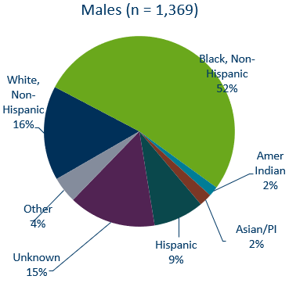

Gonorrhea Cases Among Adolescents and Young Adults† by Gender and Race, 2023
† Adolescents defined as 15-19 year-olds; Young adults defined as 20-24 year-olds. Excludes unknown/transgender/missing
Data: STI Surveillance Report Data Tables, Minnesota 2023 (PDF)
Notes:
Black, Non-Hispanic males make up 50% of gonorrhea cases in male adolescent and young adults and 41% of gonorrhea cases in Black, Non-Hispanic females.

Slide 61

Gonorrhea Rate Among Adolescents and Young Adults† by Race, Minnesota, 2023
 | White, Non-Hispanic | Black, Non-Hispanic | American Indian | Asian/PI | Hispanic
Males | 83 | 2044 | 448 | 127 | 347
Females | 145 | 2117 | 1781 | 179 | 307
† Adolescents defined as 15-19 year-olds; Young Adults defined as 20-24 year-olds.
Rate = Cases per 100,000 people based on 2010 U.S. Census counts.
Notes:
Black, non-Hispanic and American Indian males and female adolescents and young adults are disproportionately affected by gonorrhea.

Slide 62
Burden of STIs on Young Females and Communities of Color
Females and particularly females of color disproportionately bear the long-term consequences of STIs.
  68% of chlamydia or gonorrhea cases diagnosed among adolescents and young adults were females.
  33% of all chlamydia or gonorrhea cases diagnosed among adolescents and young adults were in the Black, non-Hispanic population.
People with vulvas are biologically more prone to contracting an sti, but less likely to have symptoms. Untreated STIs can have serious consequences on their health and future reproductive ability.
  Untreated STIs in people with vulvas can lead to pelvic inflammatory disease, infertility and ectopic pregnancy.
  Pregnant people are at risk of passing a STIs to their newborn, causing premature delivery, infant pneumonia and blindness.
  Importance of annual preventive and prenatal screening
Notes:
Women and particularly women of color disproportionately bear the long-term consequences of STIs.
68% of chlamydia or gonorrhea cases diagnosed among adolescents and young adults were females.
33% of all chlamydia or gonorrhea cases diagnosed among adolescents and young adults were in the Black, non-Hispanic population.
Women are biologically more prone to contracting a sti, but less likely to have symptoms. Untreated STIs can have serious consequences on their health and future reproductive ability.
Untreated STIs in women can lead to pelvic inflammatory disease, infertility and ectopic pregnancy.
Women are at risk of passing a STIs to their newborn, causing premature delivery, infant pneumonia and blindness.
This highlights the importance of annual preventive and prenatal screening.

Slide 63

Summary Characteristics of Adolescents & Young Adults†
Diagnosed With Chlamydia or Gonorrhea in 2023
Demographic | Cases | % of Total
Male | 5,107 | 32
Female | 10,696 | 68
White, Non-Hispanic | 5,285 | 33
Black, Non-Hispanic | 5,150 | 33
Am Indian/Am Native | 471 | 3
Asian/PI | 489 | 3
Hispanic | 1,897 | 12
Other more than one race | 489 | 3
Unknown | 2022 | 13
TOTAL | 15,803

Slide 64
What’s Being Done in Minnesota?
The MDH Partner Services Program continues to follow up on early syphilis cases and their sex partners and all pregnant syphilis cases.
All HIV/syphilis co-infected cases are assigned to Partner Services for follow-up.
Physicians are encouraged to screen men who have sex with men at least annually and to ask about sex partners.
All pregnant females should be screened for syphilis at first prenatal visit, 28 weeks’ gestation (at minimum 28-36 weeks), and at delivery.

Slide 65
Summary of sti Trends in Minnesota
From 2014-2023, the chlamydia rate increased by 4.3%. The rate of gonorrhea increased by 80%, syphilis has increased by 166%.
Adolescent and young adults aged 15-24 years old continue to make up the majority of all chlamydia or gonorrhea cases at 54%.
Syphilis has resurged in MN over the past decade, with MSM and those co-infected with HIV being especially impacted. However, the number of females impacted is near the record high for the last decade.
People of color and American Indians continue to be disproportionately affected by all STIs in Minnesota. Disparities in the rates of STIs are not explained by differences in sexual behavior, but are due to differences in health insurance coverage, employment status and access to healthcare with preventative, screening, and treatment services.
Notes:
From 2014-2023, the chlamydia rate increased by 4.3%. The rate of gonorrhea increased by 80% syphilis has increased by 166%.
Adolescent and young adults aged 15-24 years old continue to make up the majority of all chlamydia or gonorrhea cases at 54%.
Minnesota has seen a resurgence of syphilis over the past decade, with men who have sex with men and those co-infected with HIV being especially impacted. However, the number of females impacted is near the record high for the last decade.
people of color continue to be disproportionately affected by all STIs in Minnesota and nationwide. Disparities in the rates of STIs are not explained by differences in sexual behavior, but are due to differences in health insurance coverage, employment status and access to healthcare with preventative, screening and treatment services.

Slide 66
Health Watch: Disseminated Gonococcal Infection (DGI) (1/2)
12 cases of disseminated gonococcal infections (DGI) diagnosed in MN in 2023.
DGI occurs when a gonorrhea infection moves into the bloodstream and spreads to distant sites in the body, which can lead to clinical findings: septic arthritis, polyarthralgia, tenosynovitis, petechial/pustular lesions, bacteremia, or rarely: endocarditis or meningitis.
DGI is uncommon and occurs in 0.5-3% of untreated cases.
If there is clinical suspicion for DGI, nucleic acid amplification test (NAAT) & culture specimens from urogenital and extra-genital (e.g., pharyngeal and rectal) mucosal site(s), as applicable, should be collected and processed, in addition to culture specimens from disseminated sites of infection (e.g., skin, synovial, blood, CSF).
Source: Health Alert Template for Disseminated Gonococcal Infection (DGI) (https://www.cdc.gov/sti/program/outbreakresources/HANtemplate-dgi.htm)
Notes:
12 cases of disseminated gonococcal infections (DGI) were diagnosed in Minnesota in 2021.
DGI occurs when a gonorrhea infection moves into the bloodstream and spreads to distant sites in the body, which can lead to clinical findings, such as septic arthritis, polyarthralgia, tenosynovitis, petechial/pustular lesions, bacteremia, or on rare occasions endocarditis or meningitis.
DGI is uncommon and occurs in 0.5-3% of untreated cases.
Report all laboratory confirmed cases of DGI or concern over persistent infection to MDH within 24 hours of identification. Also please call MDH when these cases are identified at 651-201-5414.
Management of DGI cases should be guided by the CDC sti Treatment Guidelines.

Slide 67
Health Watch: Disseminated Gonococcal Infection (DGI) (2/2)
Report all laboratory confirmed cases of DGI or concern over persistent infection to MDH within 24 hours of identification at 651-201-5414.
All DGI cases should be cultured and tested for antimicrobial susceptibility. Please contact MDH for guidance on sending samples to the MDH Lab for additional testing.
Management of DGI cases should be guided by the STI Treatment Guidelines (https://www.cdc.gov/sti/treatment-guidelines/default.htm)
Source: Health Alert Template for Disseminated Gonococcal Infection (DGI) (https://www.cdc.gov/sti/program/outbreakresources/HANtemplate-dgi.htm)
Notes:
8 cases of disseminated gonococcal infections (DGI) were diagnosed in Minnesota in 2021.
DGI occurs when a gonorrhea infection moves into the bloodstream and spreads to distant sites in the body, which can lead to clinical findings, such as septic arthritis, polyarthralgia, tenosynovitis, petechial/pustular lesions, bacteremia, or on rare occasions endocarditis or meningitis.
DGI is uncommon and occurs in 0.5-3% of untreated cases.
Report all laboratory confirmed cases of DGI or concern over persistent infection to MDH within 24 hours of identification. Also please call MDH when these cases are identified at 651-201-5414.
Management of DGI cases should be guided by the CDC sti Treatment Guidelines.

Slide 68

Updates to sti Reporting and Current Follow-Up
A new chlamydia and gonorrhea case report form is available on the MDH website, to accommodate changes in treatment guidelines and highlight DGI reporting.
The case report form can be filled out and mailed or faxed to MDH at 1-800-298-3775.
More information may be requested on gonorrhea cases for Enhanced Gonorrhea Surveillance as part of the CDC PCHD grant.
All cases co-infected with early syphilis will continue to be assigned to MDH Partner Services for follow-up.
All sti cases continue to have the potential for being contacted by MDH for additional follow-up.
Notes:
A new Chlamydia and Gonorrhea case report form is available on the MDH website, to accommodate changes in treatment guidelines and highlight DGI reporting.
The case report form can be filled out and mailed or faxed to MDH at 1-800-298-3775.
More information may be requested on gonorrhea cases for Enhanced Gonorrhea Surveillance as part of the CDC PCHD grant.
All cases co-infected with Early Syphilis will continue to be assigned to MDH Partner Services for follow-up.
All sti cases continue to have the potential for being contacted by MDH for additional follow-up.

